Slide 1
Creating Breathing Space During a Pandemic
Using HALT Prevention Tools During a Difficult Time for Recovery
Community Based Mental Health Programs

Slide 2
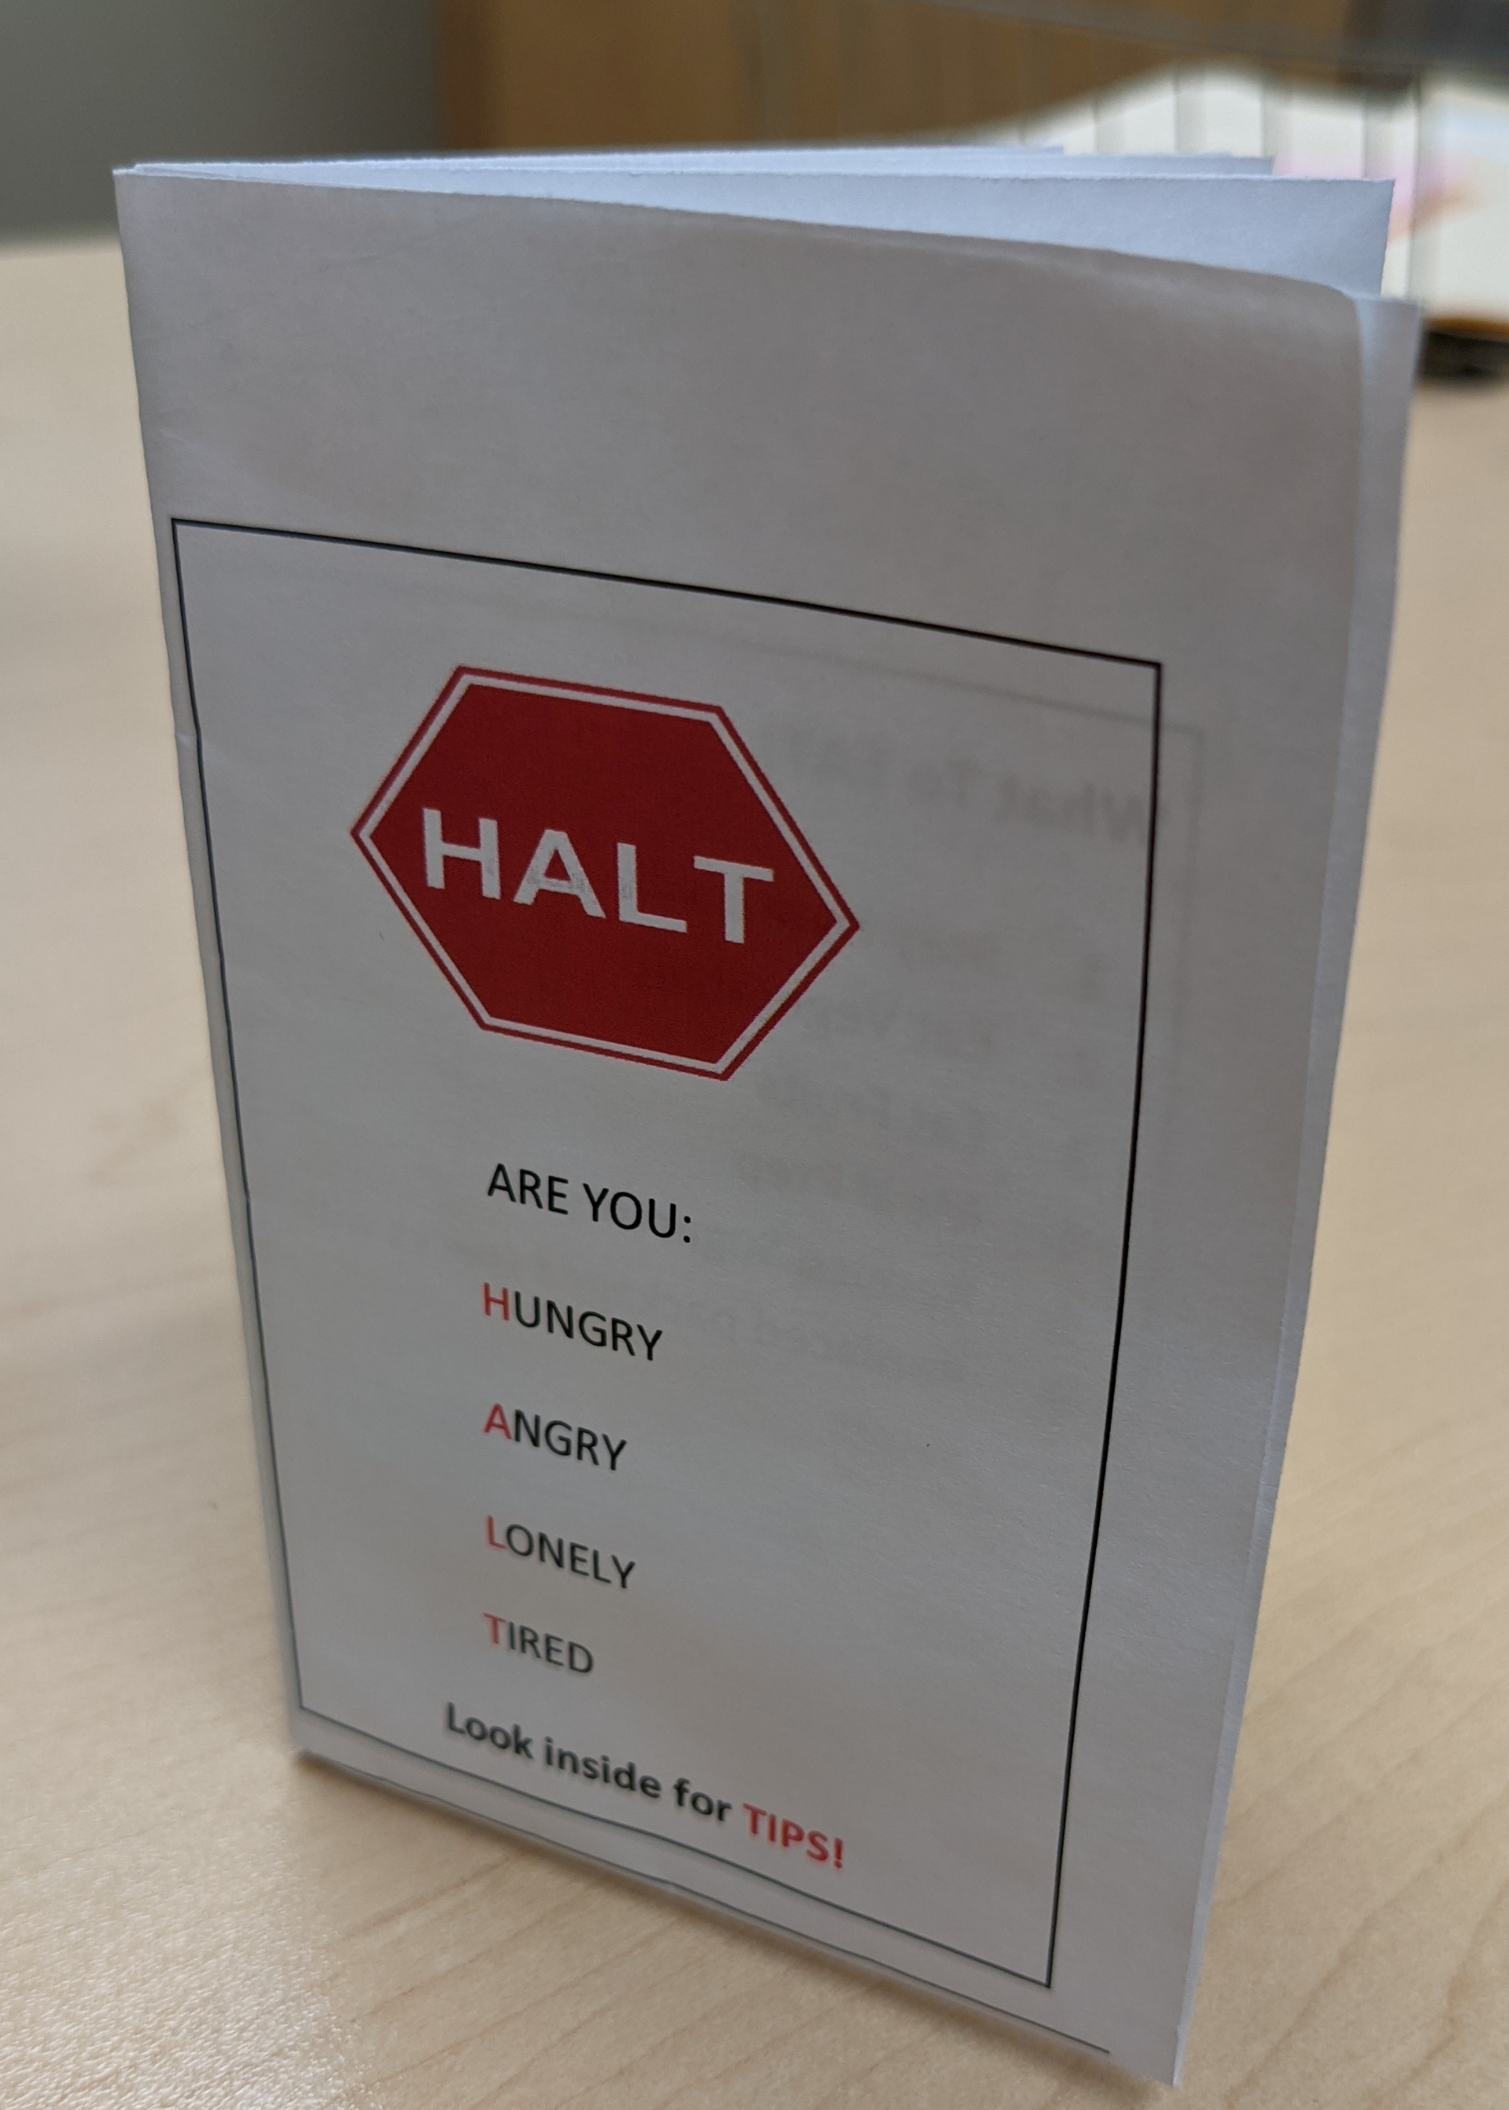
What is it and why is it important?
“The transition between emotional and mental relapse is not arbitrary, but the natural consequence of prolonged, poor self-care. When individuals exhibit poor self-care and live in emotional relapse long enough, eventually they start to feel uncomfortable in their own skin.” (Melemis, 2015)
The HALT acronym (Hungry, Angry, Lonely, Tired) identifies signs of poor self-care that may lead to relapse and use.
During the pandemic, all of these feelings are easily exacerbated by a number of negative consequences of the health emergency.
The aim is to identify stressors related to HALT indicators and provide coping strategies to participants via a simple information pamphlet and discussion with their case manager/treatment team.

Slide 3
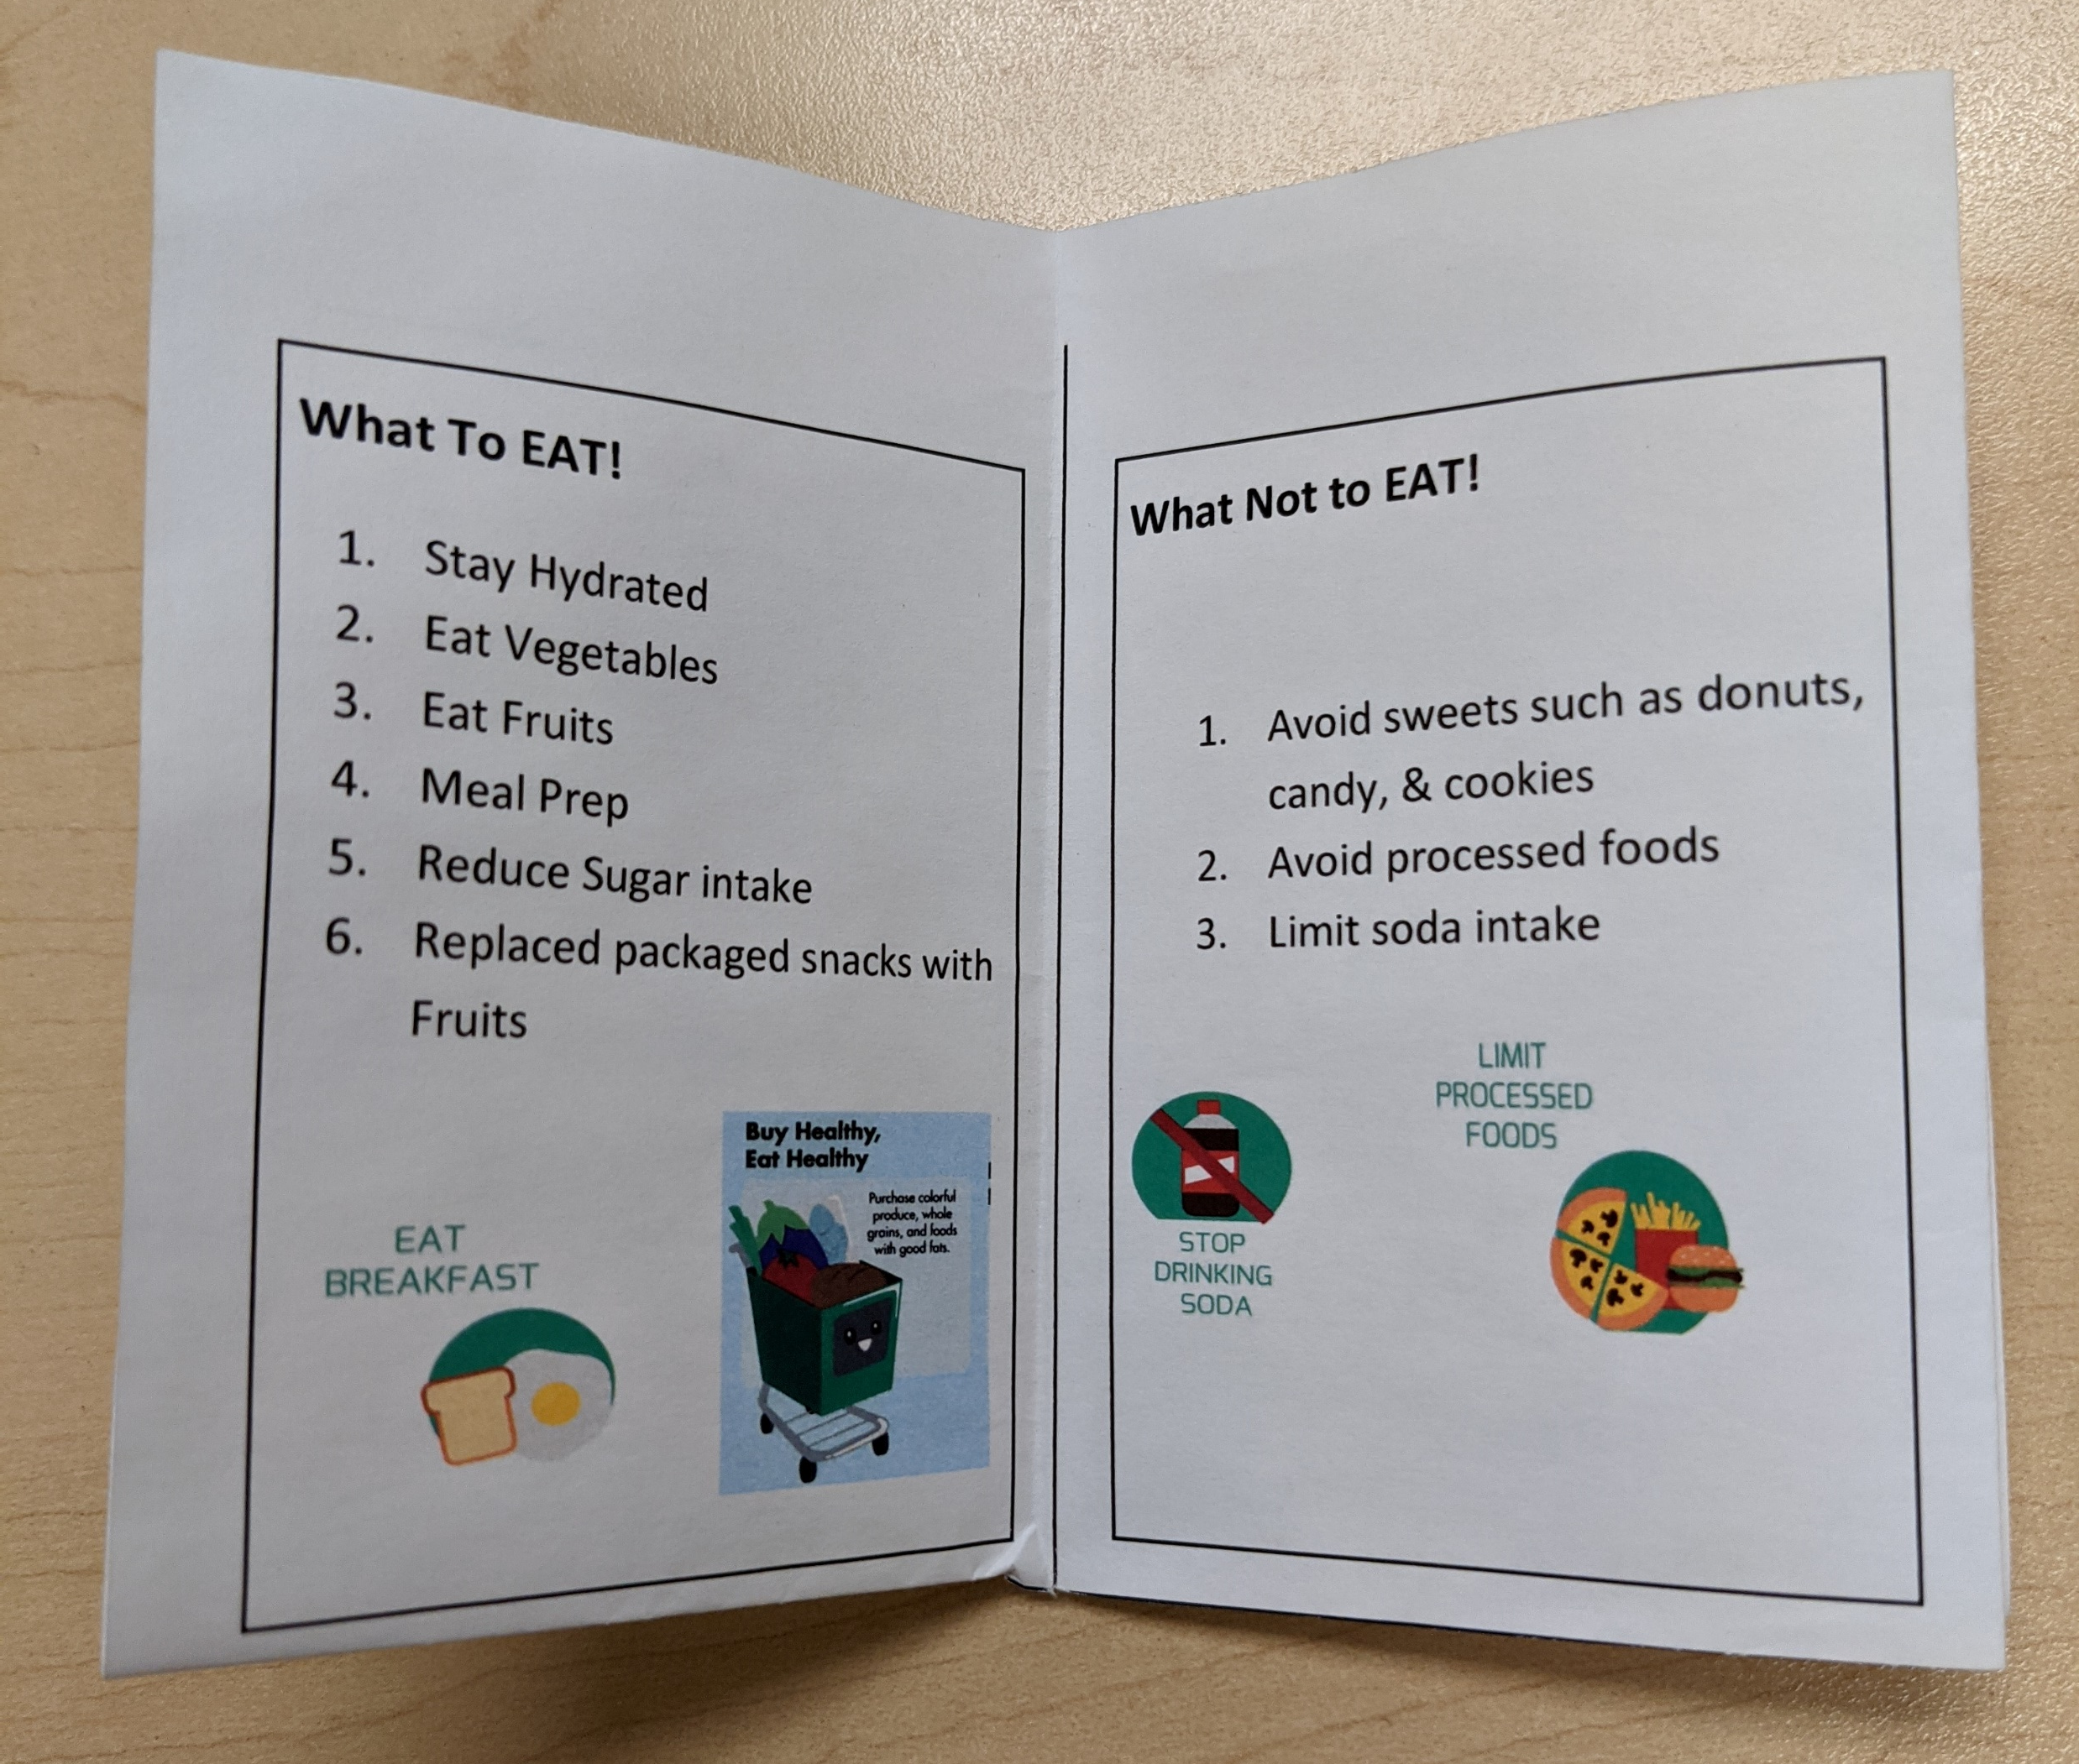
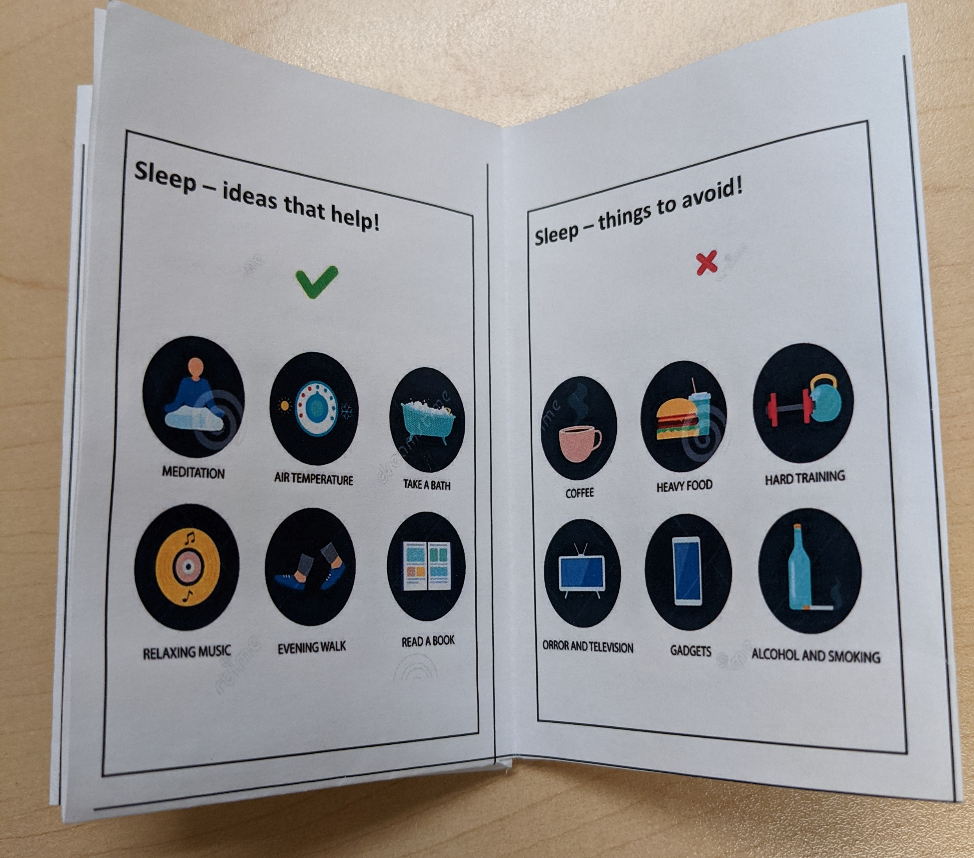
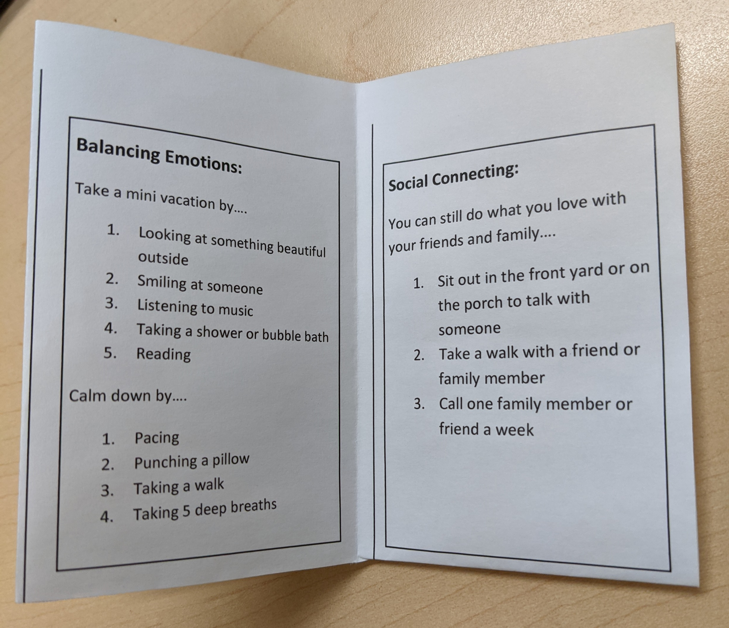
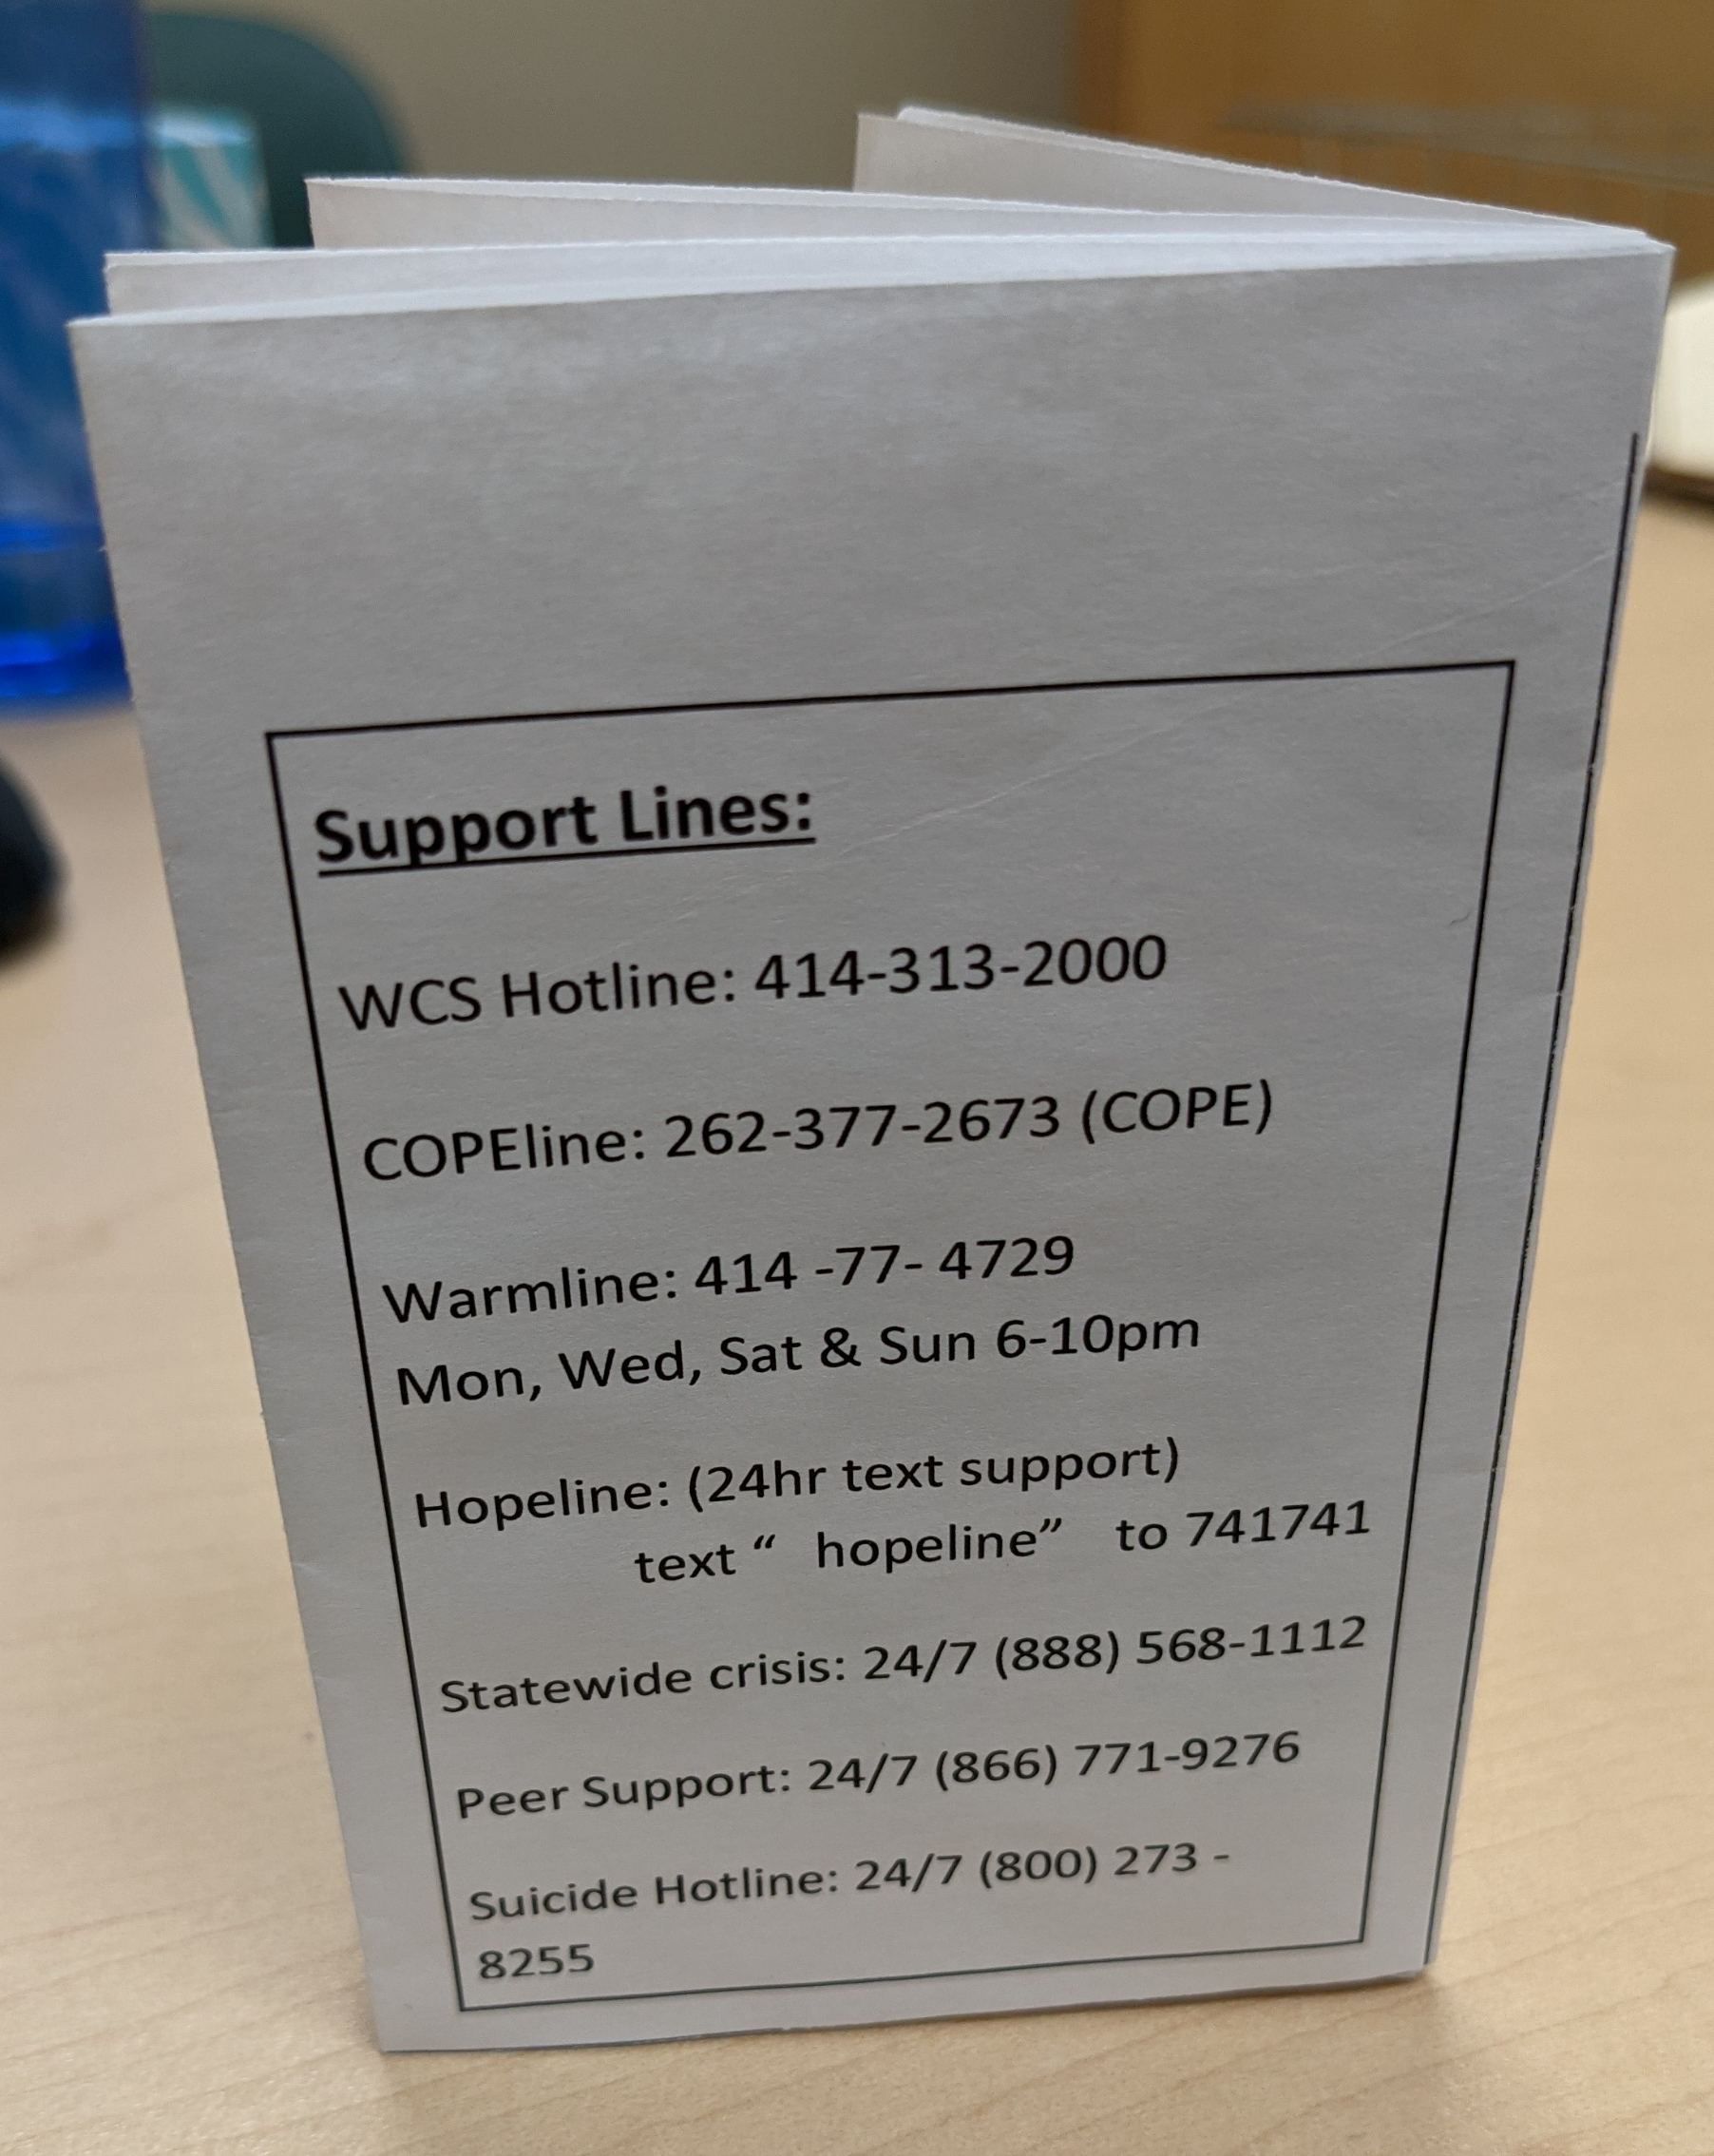
Project Details
To address these indicators, we created a small pamphlet which was provided to participants by their case manager. The case manager reviewed the pamphlet with them, and checked in with them about these indicators and continued to review the coping strategies over the next month.
Questions were asked, pre and post-test, in a survey to try to measure the outcomes. One question was asked per HALT indicator, four questions total.
This was tested with 70 TCM and CSP participants.

Slide 4
Data Collection
Survey questions used for each indicator:
H (Hungry) – On a scale of 1 to 5, 1 being non-existent appetite to 5 being no issues with appetite, how would you rate your appetite?
A (Angry) – On a scale of 1 to 5, 1 being no mood swings at all to 5 being daily mood swings, how often do you experience mood swings?
L (Lonely) – Do you feel isolated from your family and/or friends? (yes/no)
T (Tired) – How many hours of sleep do you get each night?

Slide 5
Data Collection
PRE-TEST (February 2021)
H – Average score 3.98
A – Average score 2.70
L – 35.7% report feeling isolated
T – 7.09 average hours slept
POST-TEST (May 2021)
H – Average score 3.79
10% reported increase, 25.7% decreased
A – Average score 2.89
30% of scores increased, 20% decreased
L – 20% report feeling isolated
21.4% went yes to no, 5.7% no to yes
T – 7.8 average hours slept
47.1% reported increase, 10% decrease

Slide 6
Visual Data

Slide 7
What was Learned?
A significant portion of the participants surveyed reported struggles with one or more of the HALT indicators we attempted to measure.
The data does not necessarily show a positive effect from using this tool, but this may come down to the methodology of the study and other factors.
This tool was a great opportunity for some participants to open up more and engage with their case manager regarding HALT issues.
Since it’s unclear how effective this is, it will likely not be more widely implemented. But, due to its low cost and benefit to some participants, it will definitely be made available for the case managers’ “tool box.”

Slide 8
References
Melemis, Steven M “Relapse Prevention and the Five Rules of Recovery” Yale Journal of Biology and Medicine, September 2015 Retrieved from: https://www.ncbi.nlm.nih.gov/pmc/articles/PMC4553654/

