Slide 1
Drop in AND stay awhile!
Improving membership at the Our Space Drop-In Center day program

Slide 2
Change Team
Activities and Member Coordinator
Occupational Therapist
Reception Staff
Current Members
Executive Director
Executive Assistant

Slide 3
Aim
In May 2022, our team determined that the Our Space Drop-In Center averaged 3 new members per month. Our team saw an opportunity to improve Our Space Drop-In Center membership by modifying the Our Space membership application and processing system.
Aim statement: Increase Our Space membership from an average of 3 new members per month to a goal of 5 new members per month by October 2022. This is a 66.67% increase.

Slide 4
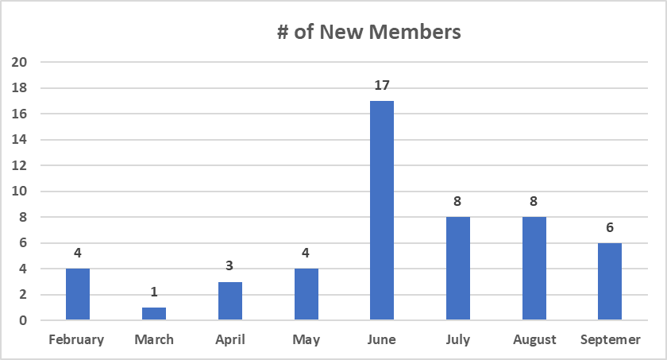
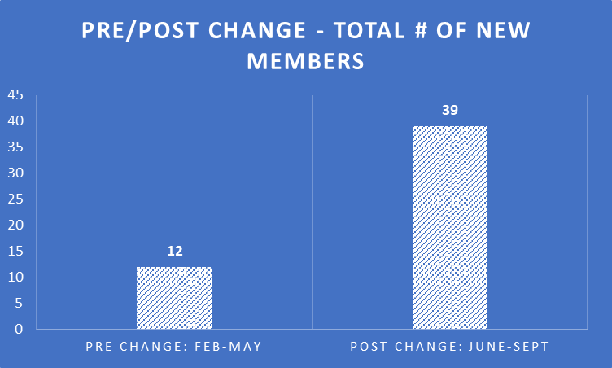
Data: February - May Average = 3 new members
June – September Average = 9.75 new members
Average number of new members increased from 3 to 9.75 members per month (225%)

Slide 5
Change
Modified member application from 3 pages to 7 pages.
Staff member conducting tours and providing direct services in the day program will process member applications.

Slide 6
Adopt!

