Slide 1
Lutheran Counseling and Family Service of Wisconsin (LCFS) MEDIOCRE TO MAGNIFICENT - Services Provided: - Outpatient Mental Health Counseling - Alcohol & Other Drug Abuse Counseling - In School Counseling - Adoption Services
LCFS has dually licensed Psychotherapists/certified Substance Abuse Counselors located in Wauwatosa:
Deb Rayburn, LPC, CSAC, CSIT, CEO
Glenn Peters, LPC, CSAC
Tajuan Conway, LPC-IT, CSAC, ICS
Sheryl Dean, LCSW, CSAC, ICS
Deborah Vanderkinter, LPC, SAC
Ann Woosencraft, LCSW
Rory Gaouette, LPC
Carol Flanary, LPC
Christina Popp, LPC-IT, SAC
Andrea Alfke, LPC
Jennifer Poe, LCSW
Presented by: Lisa Huebner, COO
Address: 3800 N. Mayfair Rd., Wauwatosa, WI 53222

Slide 2
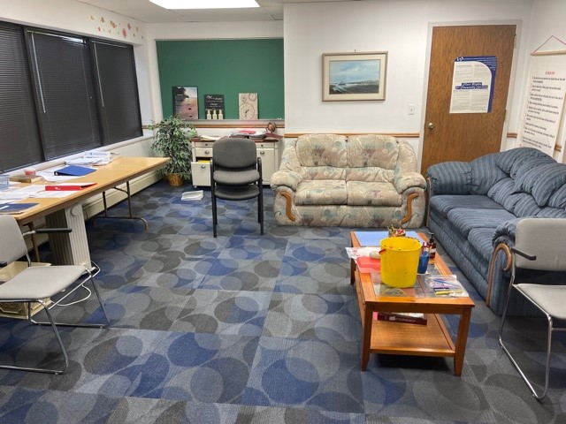
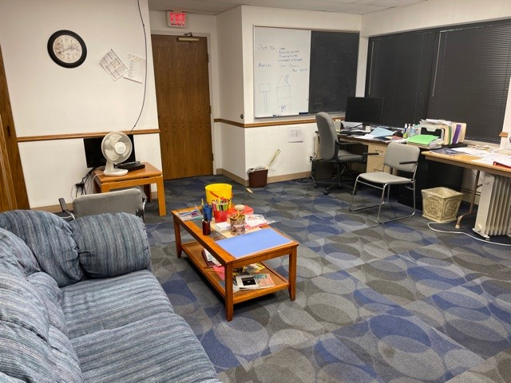
The problem was: Busy, outdated and cluttered therapy office. Alcohol & Drug Abuse Group/Individual Counseling Room AODA clients meet weekly in this room for AODA group therapy.
Angle 1
Angle 2

Slide 3
This is what we want to see:
The goal was to make clients feel more comfortable and welcomed and to provide an atmosphere for them to feel calm, encouraged, positive and inspired.

Slide 4
1. Have you observed a difference in this office? 2. Did the set up of the group room help you feel more comfortable to share your thoughts/feelings? 3. Has the feel of this room impacted you? 4. Does having more space (with less clutter) help you to focus more easily? 5. Does the room feel calmer then it did before? 6. Do you feel additional changes need to be made to the room? 7. What’s something we could do in the future to make LCFS better?

Slide 5
Client Testimonials: “The room feels Feng Shui” “The office felt depressing before, now atmosphere feels good” Psychotherapist Testimonial “I didn’t think the office could look this good, makes me want to cry”

Slide 6
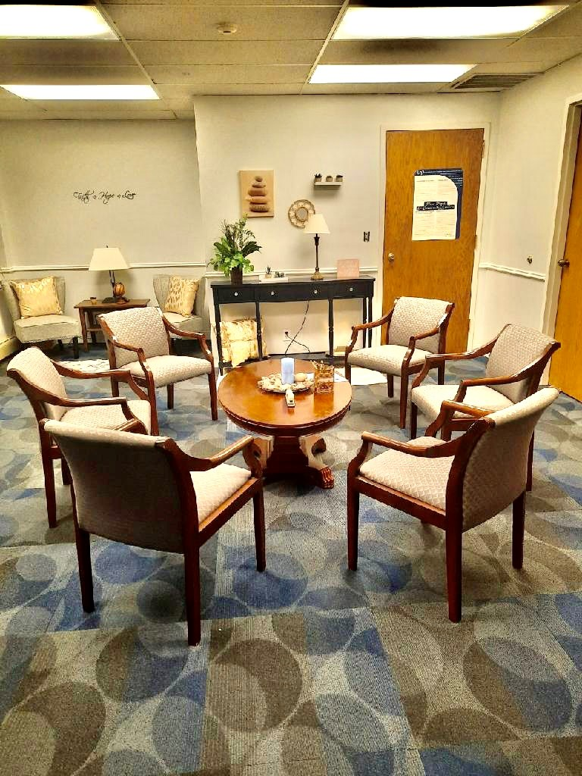
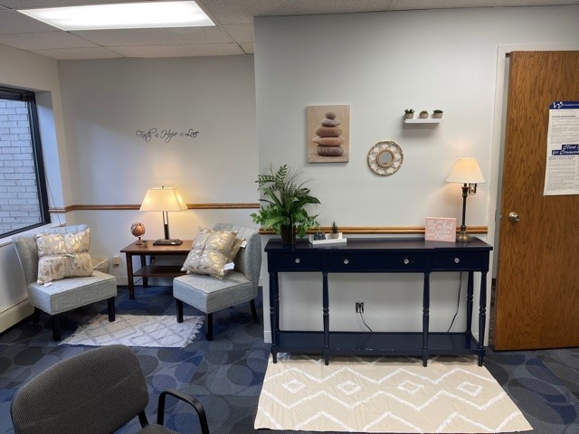
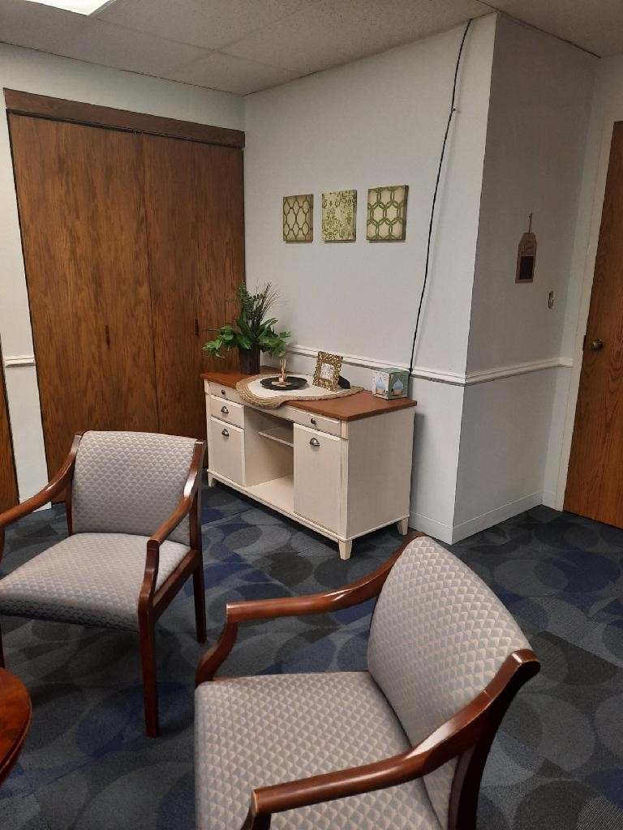
Final results:

