Slide 1
Quality Improvement Collaborative 2023
Healing Starts Today
Our mission is to disrupt any abusive activities and fight to empower our community with the proper tools for healing and achieving self-wellness

Slide 2
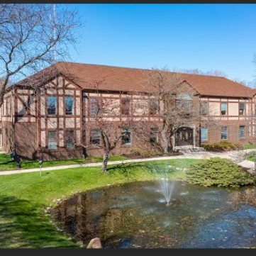
The Challenge
Lack of Accessibility & Engagement
Strategic office designs and accessibility ensure the well-being of everyone in the office, enhancing productivity. Elements such as natural lighting, ergonomic furniture, and greenery can drastically improve mental health. Higher productivity levels lead directly to better client service and thus client success.

Slide 3
Aim: Create a client friendly office to improve engagement
Welcoming environment where clients feel safe
Providing a positive, trustworthy, and comfortable environment to the client where they feel safe and heard.
Motivating patients during in-office engagement is crucial for their overall well-being and active participation in their healthcare journey.
Ergonomics: Prioritize ergonomic furniture and equipment. Comfortable chairs, adjustable desks, and proper keyboard/mouse placement reduce strain and improve focus.
Lighting: Natural light is ideal, but if that’s not possible, invest in full-spectrum lighting. Proper lighting reduces eye strain and positively impacts mood.
Temperature Regulation: Maintain a comfortable temperature. Cooler offices (around 72°F) tend to be more productive.
Personalization: Clients can create and hang artwork or vision boards to familiarize the space.
Designated relaxation spaces. Encourages breaks for client and provider with comfortable seating, games, or a kitchenette.
Collaboration Zones: Foster teamwork with collaboration areas. Whiteboards, couches, and standing desks encourage creativity.
Cleanliness: Regularly clean and declutter. A tidy space promotes focus and professionalism.
Wellness Programs: Offer wellness initiatives like yoga classes, mental health resources, individual skill development, peer support and wellness management.
We believe a well-designed office environment contributes to Client happiness, engagement, and overall success. 🌟

Slide 4
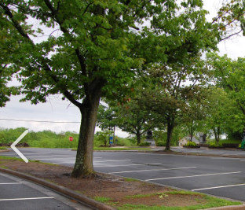
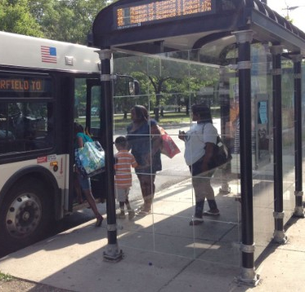
Parking & Pubic Transportation
Removing geographical barriers and provide patients with convenient access to healthcare services. Clients can engage with providers easily; reducing the need to miss session and eliminating time constraints.
This accessibility encourages patients to seek care when needed, resulting in better engagement and improved health outcomes.

Slide 5
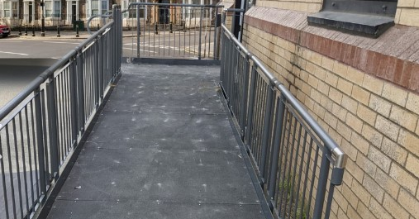
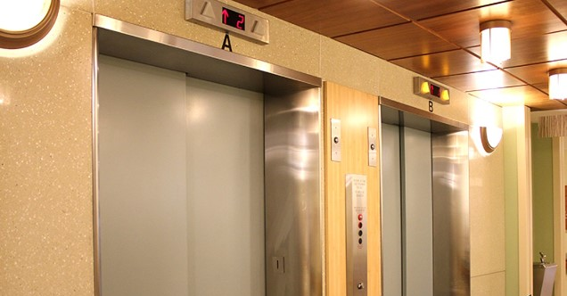
ACCOMMODATIONS FOR INDIVIDUALS WITH MOBILITY IMPAIRMENTS Physical Environment
In compliancy with Americans with Disabilities Act to make sure Clients using mobility aids can access our hallways, bathrooms, and doorways. Also, to ensure clients using walkers, wheelchairs, canes, and crutches can navigate our office space easily.

Slide 6
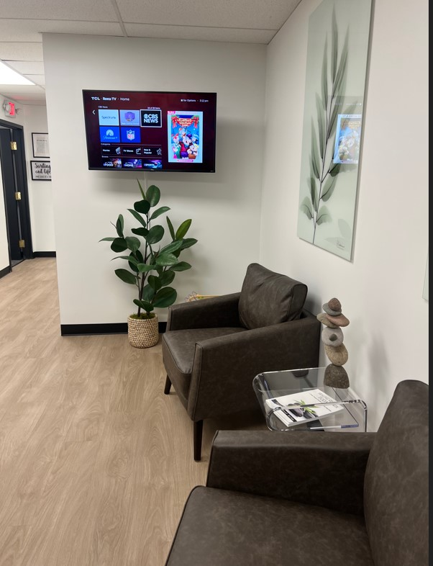
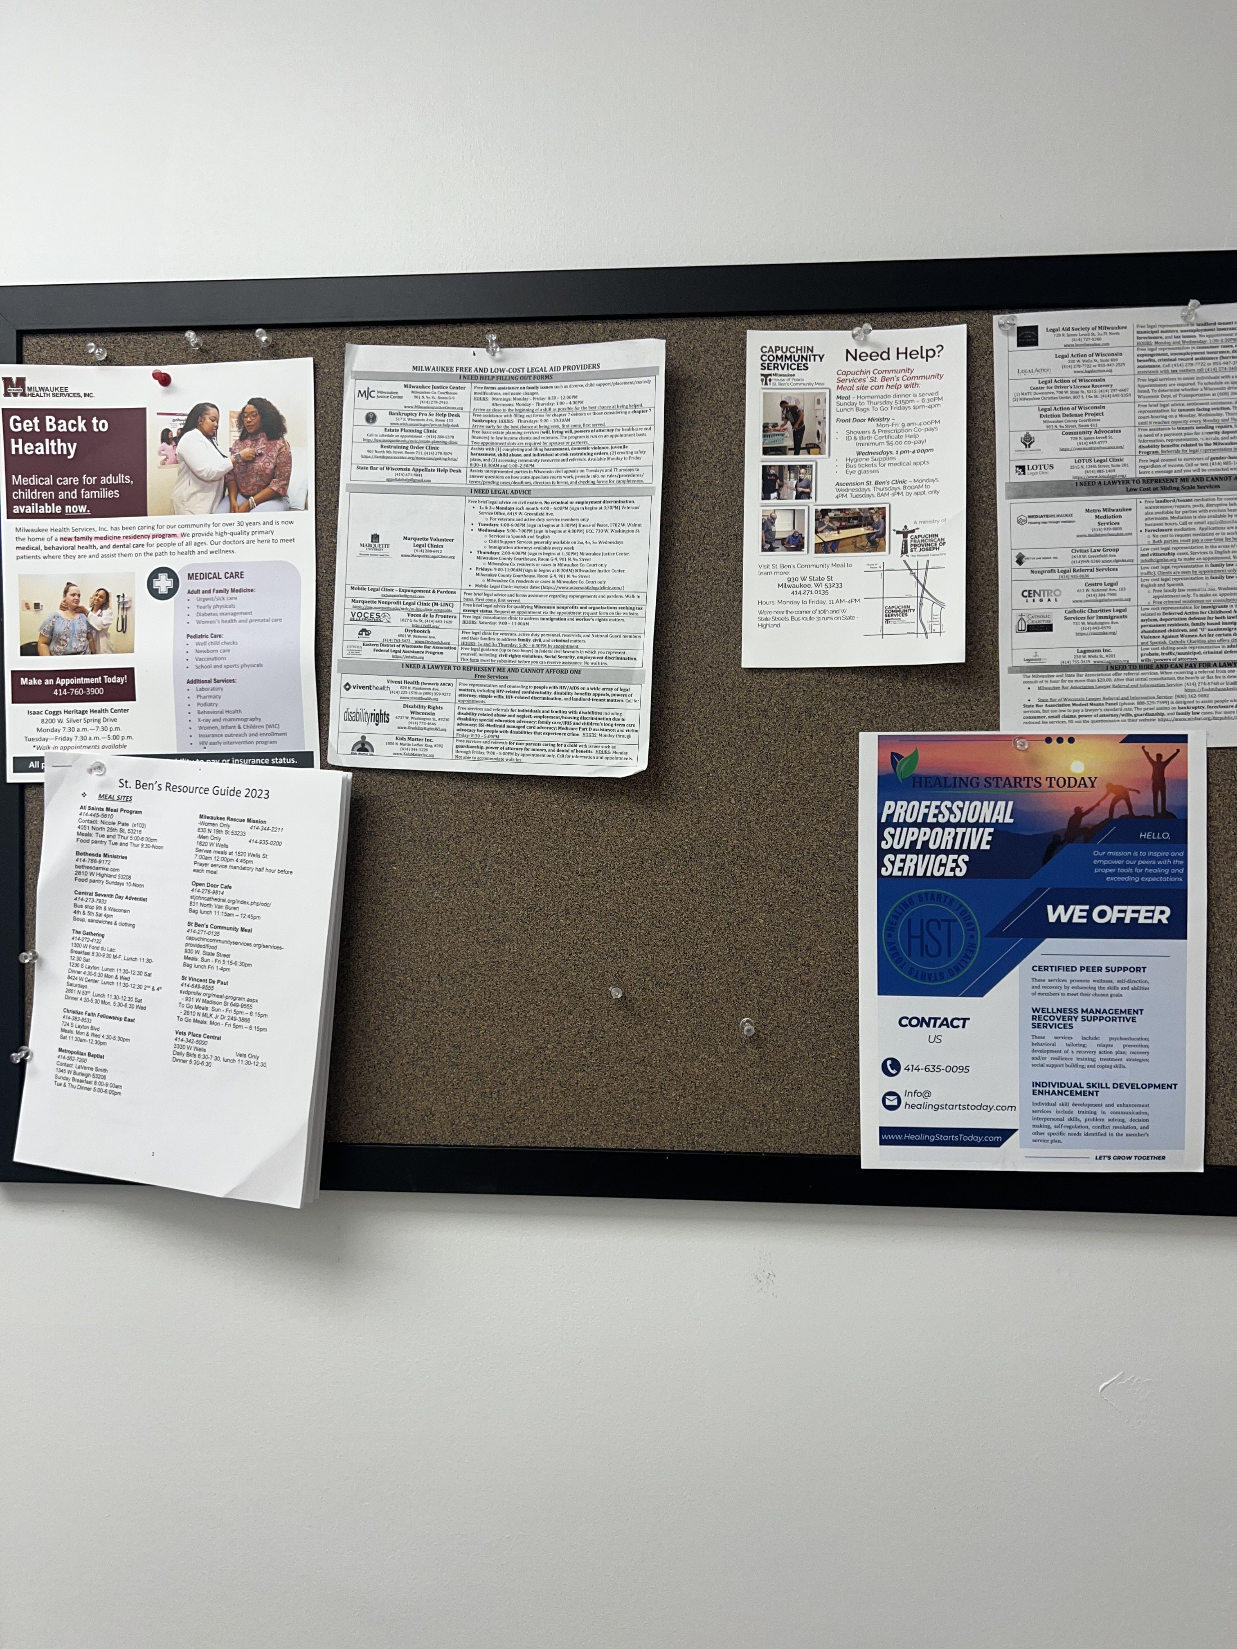
Available Resouces In A Friendly Environment
The Space
With few basic pieces of furniture to avoid cluttering the HST office. In addition to making movement easier for our Clients to use mobility aids, having an open space helps facilitate the therapy process: open space often seems more inviting, our open rooms help our Clients feel more ready to share their thoughts.
Resources
Available are also beyond the HST office, providing Client care, breaking comfort zones, and ensuring access to essential services. Providing community resources play a crucial role in enhancing well-being and fostering resilience. Offer educational resources in different formats, such as written materials, audio recordings, or video presentations, to accommodate different learning styles.

Slide 7
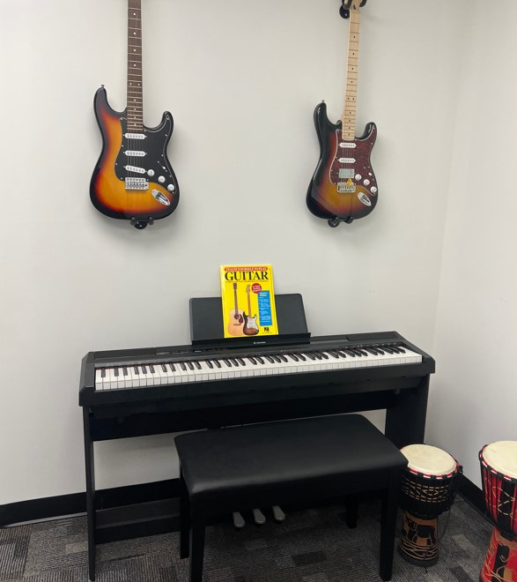
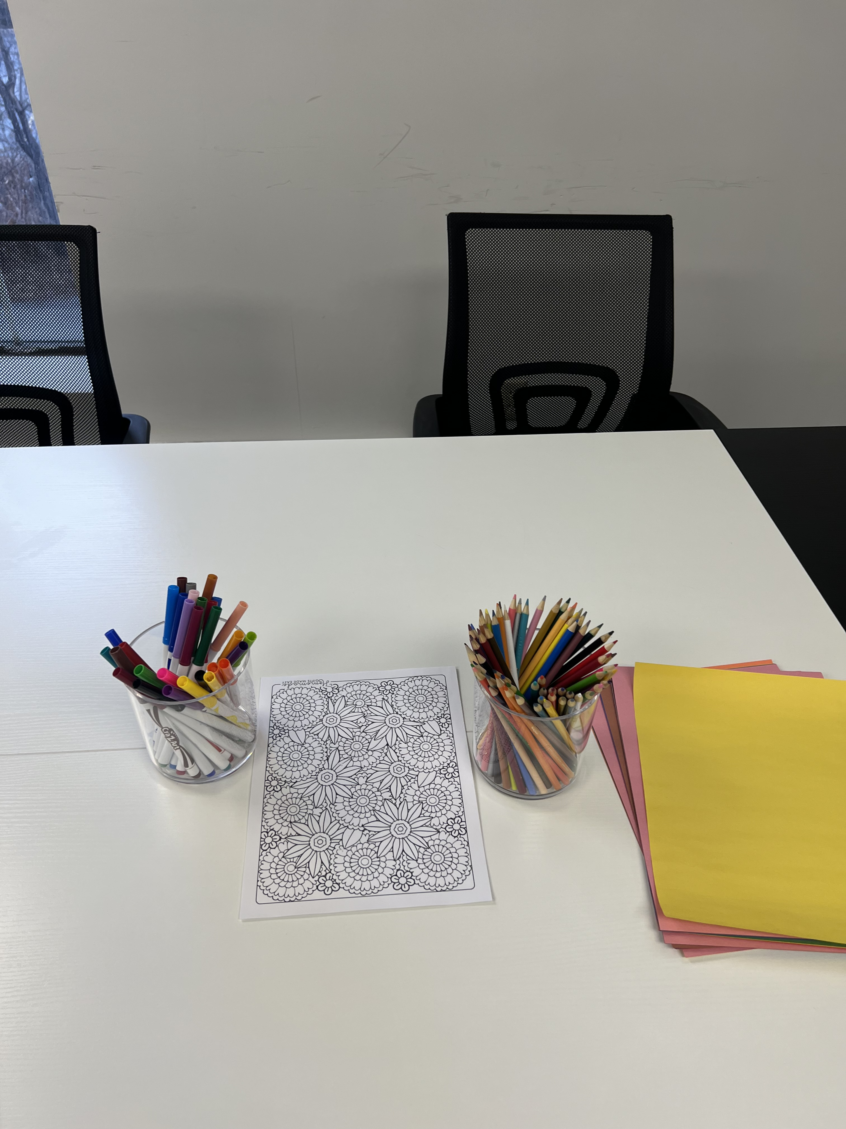
The Arts
Art can move our emotions, reduce stress, energize creativity, stimulate critical thinking and provide space for personal reflection and shared conversation.
Clients may often get bored and lose interest in the session, especially if it has been going on for a while. To prevent this, many providers mix and match their interventions and randomly implement them in the sessions.

Slide 8
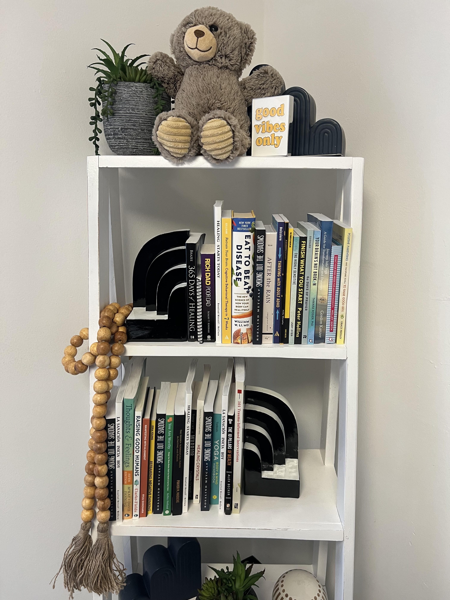
Growing In-Office Library for Clients Narrative Absorption
The experience of being immersed or engaged while reading a story is called narrative absorption and serves as more than an innately pleasurable experience—it can also enhance our sense of wellbeing. Researchers believe that mentally transporting ourselves away from our physical surroundings can provide an escape or opportunity for meaningful contemplation.
Researchers are investigating the impact of reading experiences and reporting evidence of promising mental and social health benefits. Whether reading alone or with others, people are finding connection and meaning between the pages, giving their mental health a boost along the way.

Slide 9
Indoor Planting System
Improved Air Quality
Stress Reduction
Enhanced Well-being
Noise Reduction: Plants can help to absorb sound and reduce noise levels, creating a quieter and more peaceful environment within healthcare facilities.
This approach aims to connect people with nature and create spaces that promote better health and well-being.
Increased Productivity
Aesthetically Pleasing: Indoor plants can greatly enhance the visual appeal of healthcare spaces, making them more welcoming and pleasant for patients, visitors, and staff.

Slide 10
Relaxing Outdoor Area
Spending time in nature helps to reduce anxiety, burnout, depression and stress. It boosts immune function and improves cardiovascular, respiratory and reproductive health.

