Slide 1
BETTER SAFE THAN SORRY
Sixteenth Street Community Health Center CCS
NIATx Project 2023

Slide 2
PROJECT AIM
To increase feelings of personal safety amongst staff when conducting visits with consumers both in the office and in the community

Slide 3
WHAT WE DID
The following interventions took place between February 2023 to present:
Team members reviewed and discussed Personal Safety Tip Sheet & Risk Assessment Tool
Each staff member was given whistle/personal alarm to carry
Staff participated in 2-Day CPI Non-Violent Crisis Intervention Training
Staff members shared details on Microsoft Outlook calendars to increase awareness of where they are and when
Developed "New Consumer" Info sheet to utilize during consultation between Intake Coordinator and incoming Care Coordinator

Slide 4
WHAT WE FOUND
In pre-survey administered in February 2023, 70% of staff identified that personal safety is an area of concern
Out of all the interventions employed, staff found the sharing of details on their Outlook calendars to be the most helpful
Other ideas from staff include:
Check-in/Check-out procedure when conducting home visits
Shifting more towards meeting in public spaces/in-office rather than in-home
Employing "buddy" system on visits if needed
Upgraded work phones
Narcan training

Slide 5
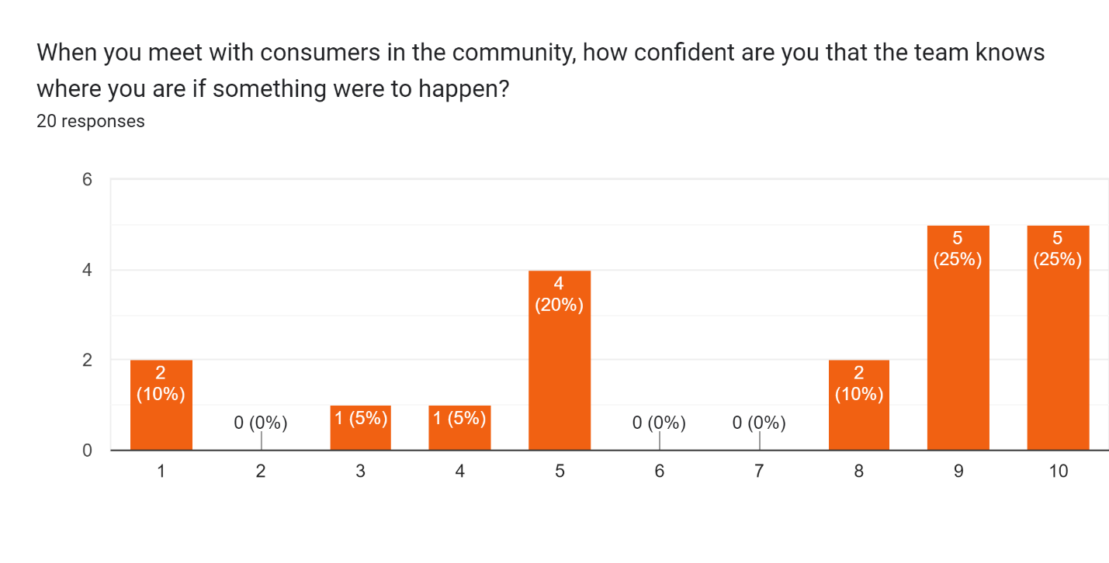
WHAT WE FOUND (CONTINUED)
February 2023 (4.5 average)
September 2023 (7 average)

Slide 6
NEXT STEPS
Continue using interventions!
More trainings!
Policy/procedure changes!
Continue the discussion!

Slide 7
THANK YOU!

