Slide 1
Review third-party transportation issues to improve attendance at therapy sessions.
Willow Creek Ranch – Equine Assisted Services is located in Mukwonago, Wisconsin. Services for Milwaukee County CCS consumers frequently involve a third-party provider for transportation to and from WCR, a 25 to 40 minute drive.

Slide 2
Change Team WCR Executive Director Two MH therapists Sr Facility Manager of transportation company Additional stakeholders as advocates: CCS Consumers DHS/Milwaukee & Wisconsin DHS Collins Engineering – road construction representative

Slide 3
Opportunity to change and improve 2022 – Transportation issues with Milwaukee CCS consumers having difficulty with Transport company (Transport). This includes late home pickup, late pickup after session at WCR, and Transport no-show. The executive director and therapists worked with Transport Sr. Facility Manager to discover and correct transportation issues. 2023 – Transport continued to be an issue. An additional concern was that Wis. DOT designated Hwy 83 for improvements and repaving which began in April. Hwy 83 runs directly in front of WCR. Road closures and barricades caused difficulty with drivers, who at times would refuse transport. GPS navigation systems did not recognize WCR address during construction. Consumers who drove themselves had minimal issues navigating the road construction.

Slide 4
Negative impact on consumers and staff . One consumer withdrew because of the stress of transportation. . At least one consumer was told the driver would no longer go to WCR and couldn’t reschedule. . At least one consumer was told by the driver to walk through the construction to be picked up. The consumer walked through uneven road, heavy equipment, and dump trucks. The consumer, who is both physically and mentally fragile, was extremely upset, emotional and “scared.” . One WCR therapist informed WCR that she may be unable to continue services because of planning for consumers and then many do not show up because of transportation. It is a loss of income and services for the consumer, therapist and WCR.

Slide 5
GOALS . Decrease absences due to transportation issues. . Work with Transport company to correct issues affecting consumers and improve their driver awareness. . Alleviate travel issues caused by road construction. . Decrease consumer anxiety for transportation issues; have them advocate for themselves.

Slide 6
Process 2022 – Issues were sent by email to Transport and WCR received a report on the investigation. January 2023 – Transport activated RideView for staff to access ride information. January 2023 – Transport provided online complaint forms. April 2023 – Road construction updates received throughout the construction project from Engineering firm were forwarded to Transport and to WCR staff. Additional WCR road signage added to help navigate route changes. June 2023 – Transport provided updated process with phone number to report late rides, denial of ride, complaints and rescue rides. This offered a more direct and timely reporting. However, they no longer provide investigative reports to WCR. June – September 2023 – Issues continue to be reported to the Transport company.
Month 2023 | Transport issues resulting in cancellation
January | 6
February | 6
March | 9
April | 17
May | 11
June | 7
July | 17
August | 16
September | 6

Slide 7
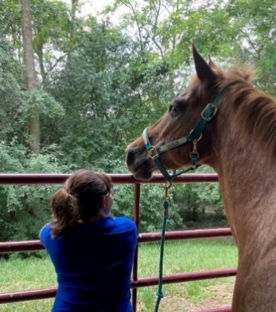
Some successes, some challenges remain. Looking to future improvements. The project is ongoing but has improved reporting of issues. An unexpected benefit. ….for mental health therapists, it became an opportunity to help consumers discover their own advocacy and work through anxiety and anger.

