Slide 1
5 for 5
Self Care &
Burnout Prevention at
Guest House of Milwaukee

Slide 2
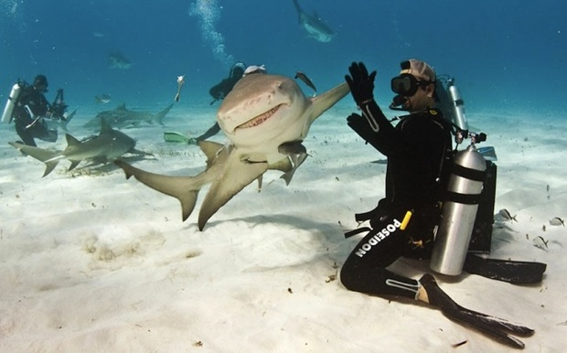
QA Auditor CCS Supervisor CCS MHP/SAP CCS Director Director of Government Contracts and Quality Assurance
Change Team

Slide 3
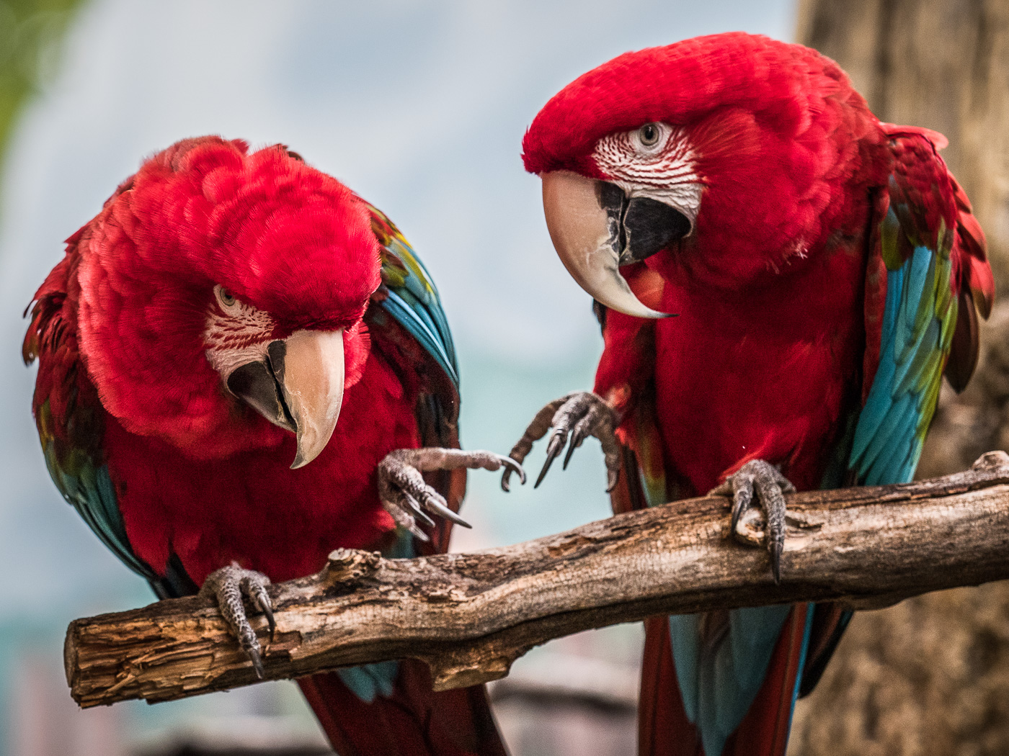
Aim
Improve staff self report of stress levels and ability to bounce back by 14% each
(2 staff)

Slide 4
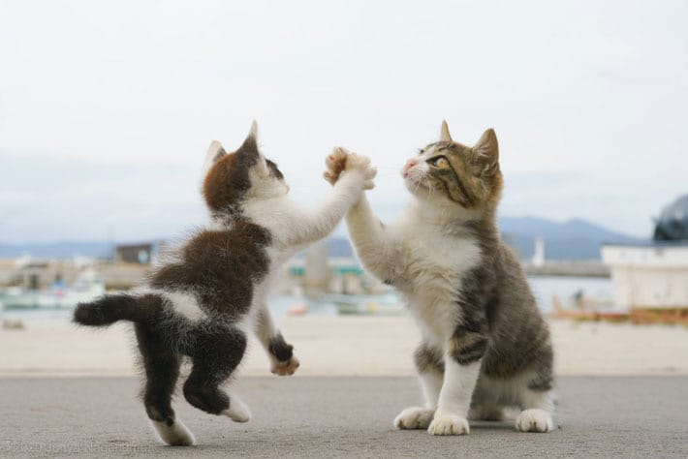
Change
Spend the first 5 minutes of every CCS group meeting with management giving verbal high 5’s
Meetings can be done in person or virtually as needed.

Slide 5
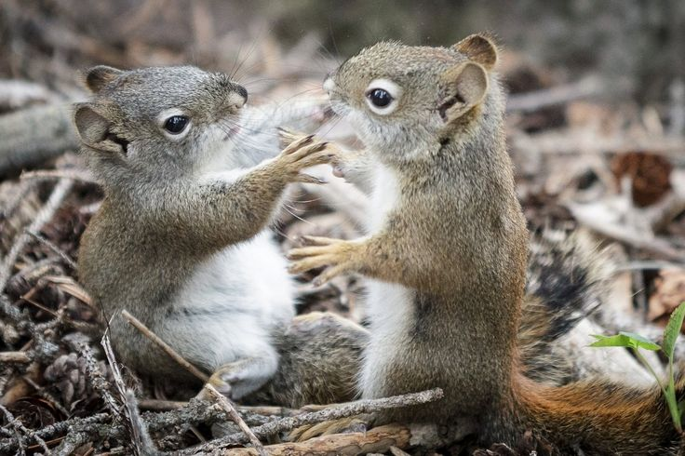
Results
Recently my stress levels have felt manageable
I feel able to bounce back as quickly as I usually do
An increase of 14% (2 staff) for each measure achieved!

Slide 6
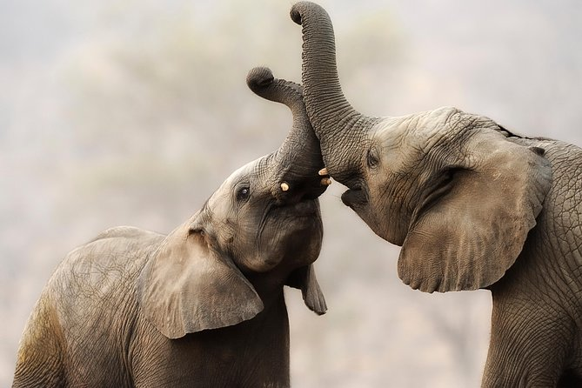
Next Steps: Adopt
With 75% of staff participating in the pre and post tests we are fairly confident that the results reflect the staff as a whole.
5 for 5 will continue!
The CCS management team has also accepted staff’s challenge to explore and implement additional changes they suggested.

Slide 7
Impact
Management report intentionally looking for positive feedback to report out on a continuous basis. This is not perceived as an overwhelming task.
Staff report feeling more energized and ready to start day after morning meetings.
Meetings rarely take more time.
Spill over effect. More communications (i.e.: email) tend to include more random praise. Praise is being offered to other agency departments.

