Slide 1
BUDS of MC3
Out of the maintenance of M Seeds 3 NIATx project, Buds of MC3 project was formed.

Slide 2
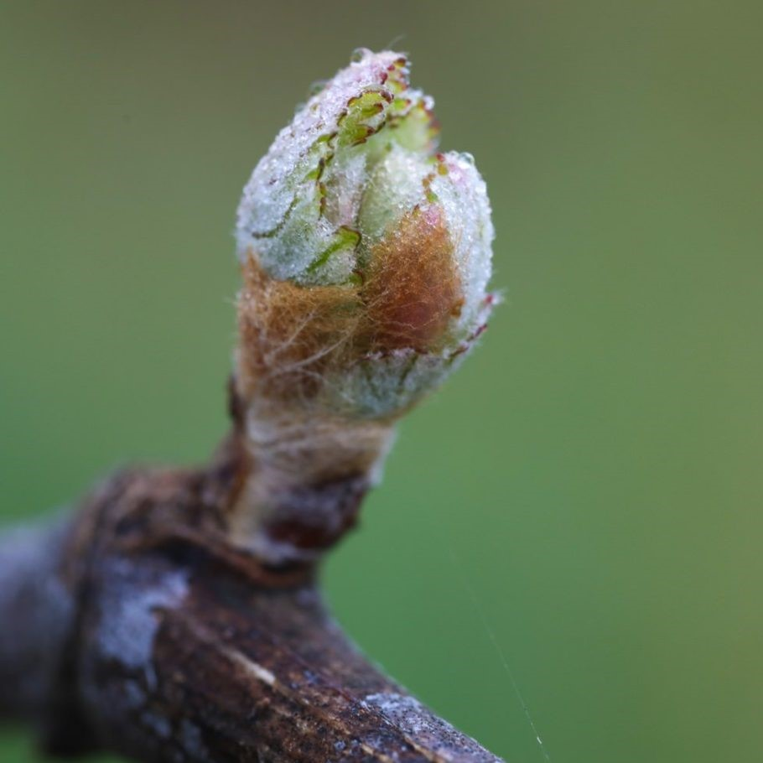
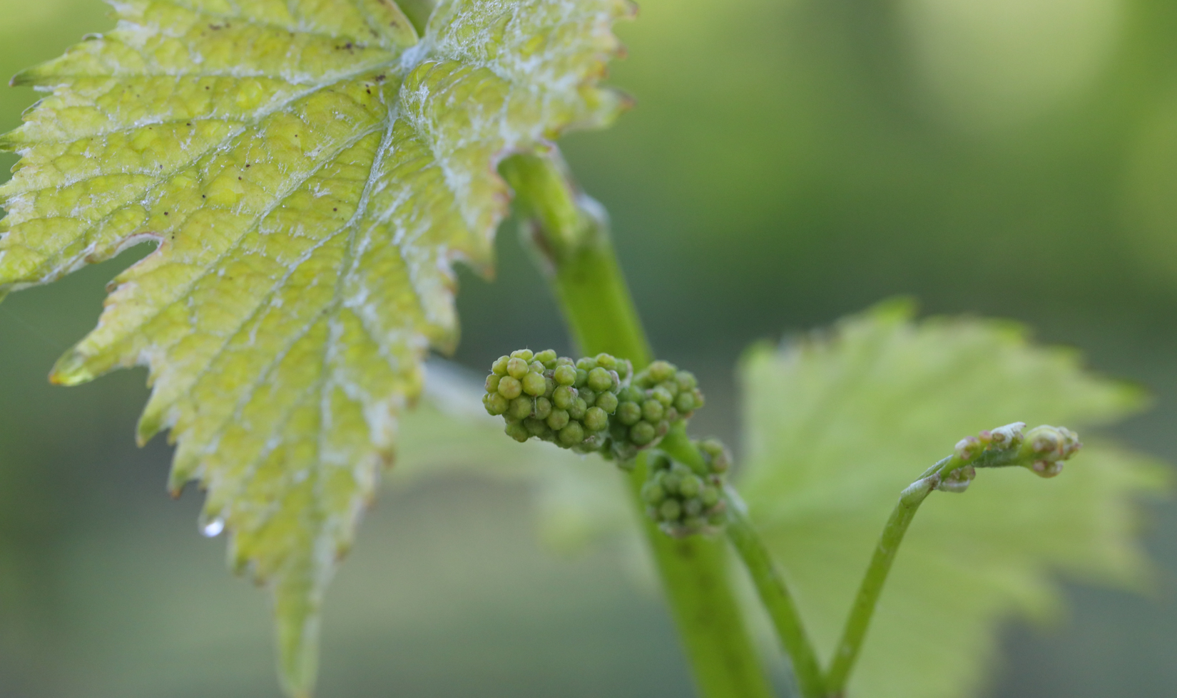
APC aims to increase staff's demonstration of all MC3 Values.
Aim: To Increase the utilization of all MC3 values to at least 90% amongst all staff.
Baseline: 45% of respondents utilized a co-occurring strategy in the initial survey followed by additional focus on each value.
Target Goal: By increasing the ability for staff to demonstrate MC3 values, we will positively impact those we serve and hopefully increase recovery.

Slide 3
APC aims to increase staff's demonstration of all MC3 Values

Slide 4
Steps taken to improve knowledge of values.
Initial survey Identifying knowledge of each Value.
Each department talked about it during staff meetings.
Survey was sent out to test knowledge of Value.

Slide 5
Lessons Learned: 1.) Leadership/Supervisors focusing on values by reviewing the MC3 Shadowing Checklist document in supervision was helpful to staff in demonstrating MC3 values in the field. 2.) Because the surveys provided examples on how to demonstrate the values, staff realized they were already actively utilizing the MC3 values more often than they thought.
APC NIATx Project 2020-2021

