Slide 1
More Resources, Less Hassle
PRESENTATION BY: WHOLE HEALTH CLINICAL GROUP OF CFI

Slide 2
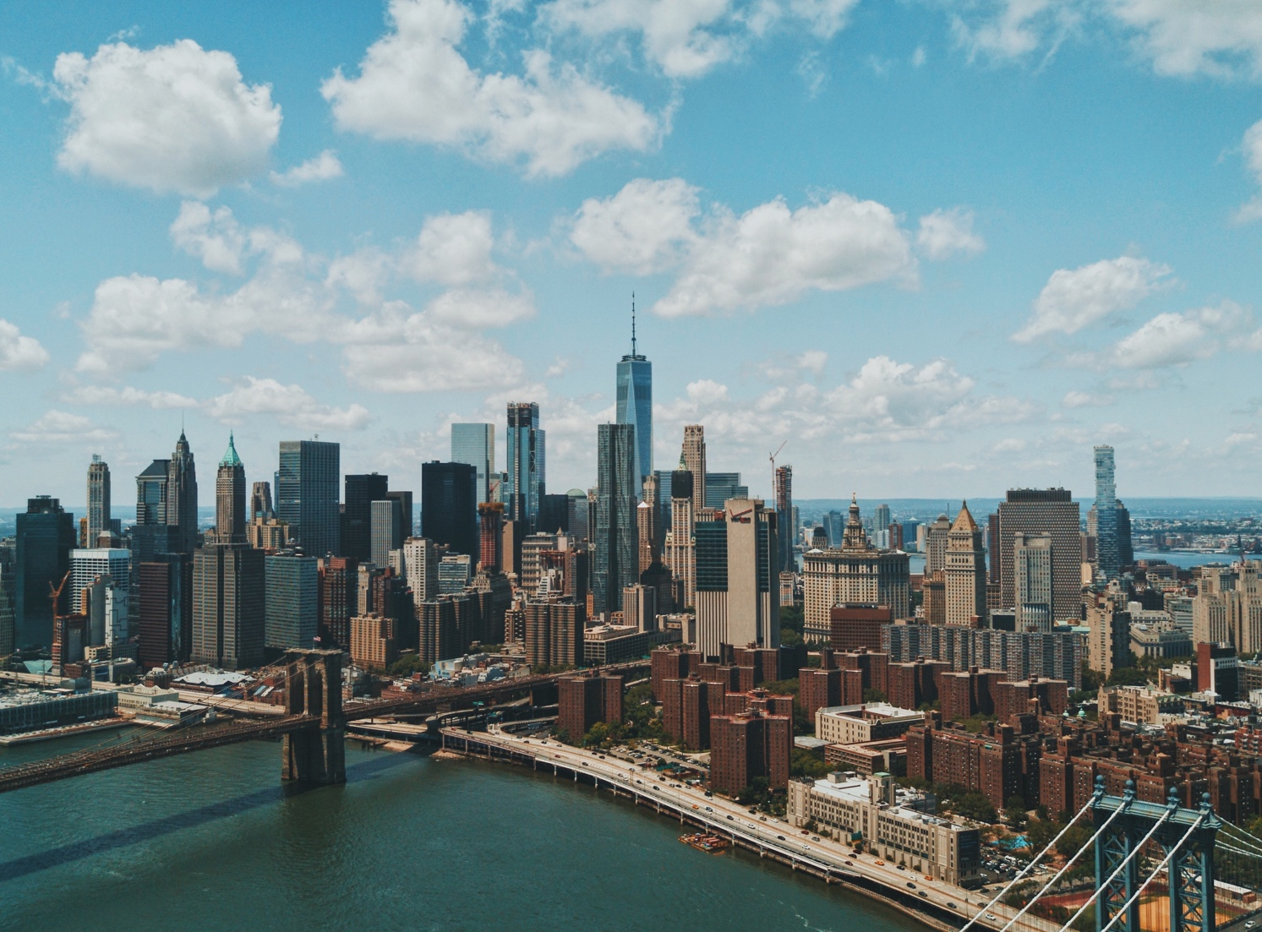
Aim Statement
To improve available resources to our consumers and make our lobby more welcoming
Notes:
SHANTEL. Moved from one location to another

Slide 3
Pre-Project Survey Questions
How satisfied are you with the current resources that Whole Health Clinical Group has available to you?
Very satisfied
Satisfied
Neither satisfied nor dissatisfied
Dissatisfied
Very Dissatisfied
How satisfied are you with the clinic’s environment (how welcoming or inviting it is)?
Very satisfied
Satisfied
Neither satisfied nor dissatisfied
Dissatisfied
Very Dissatisfied
Notes:
SPENCER. Needed to gather more information, so the best way was to make up a survey and put it out in our lobby. May to June it was out

Slide 5
Below is a list of different topics. Please circle the ones that are most important to you.
Legal Services Family Care
Substance Abuse/AODA Smoking cessation
Clothing resources Food Pantries
Household/hygiene product resources Energy assistance
Education & job training Transportation
Domestic violence resources Warming/cooling centers
Low-income housing Therapy
Resources for pregnant women Homeless Shelters
Comprehensive Community Services (CCS) Program
***The top three requested were CCS brochures, food pantries, and transportation***

Slide 6
Post-Project Survey Questions
How satisfied are you with the current resources that Whole Health Clinical Group has available to you?
Very satisfied
Satisfied
Neither satisfied nor dissatisfied
Dissatisfied
Very Dissatisfied
How satisfied are you with the improvements in the clinic’s environment (how welcoming or inviting it is)?
Very satisfied
Satisfied
Neither satisfied nor dissatisfied
Dissatisfied
Very Dissatisfied
How satisfied are you with the improvements in the clinic’s resources available?
Very satisfied
Satisfied
Neither satisfied nor dissatisfied
Dissatisfied
Very Dissatisfied

Slide 8
Project Summary
Hung motivational wall décor and improved aesthetics of environment
Created a stimulation table with fidget sensory objects
Received donation of winter hats and scarfs
Placed coloring relaxation mandalas with colored pencils
Multiple decks of playing cards
Whiteboard behind reception desk that lists the manager and case manager on duty for the current day
Hung a resource wall mount where the requested resources were displayed
“I have a consumer who comes to WHCG quarterly for an injection and typically he gets very anxious waiting for the nurse to come and get him, but yesterday I didn’t sense any anxiety or nervousness from him as he was able to distract himself with the art supplies. He really enjoyed them, so thank you!” –a TCM case manager from APC

