Slide 1
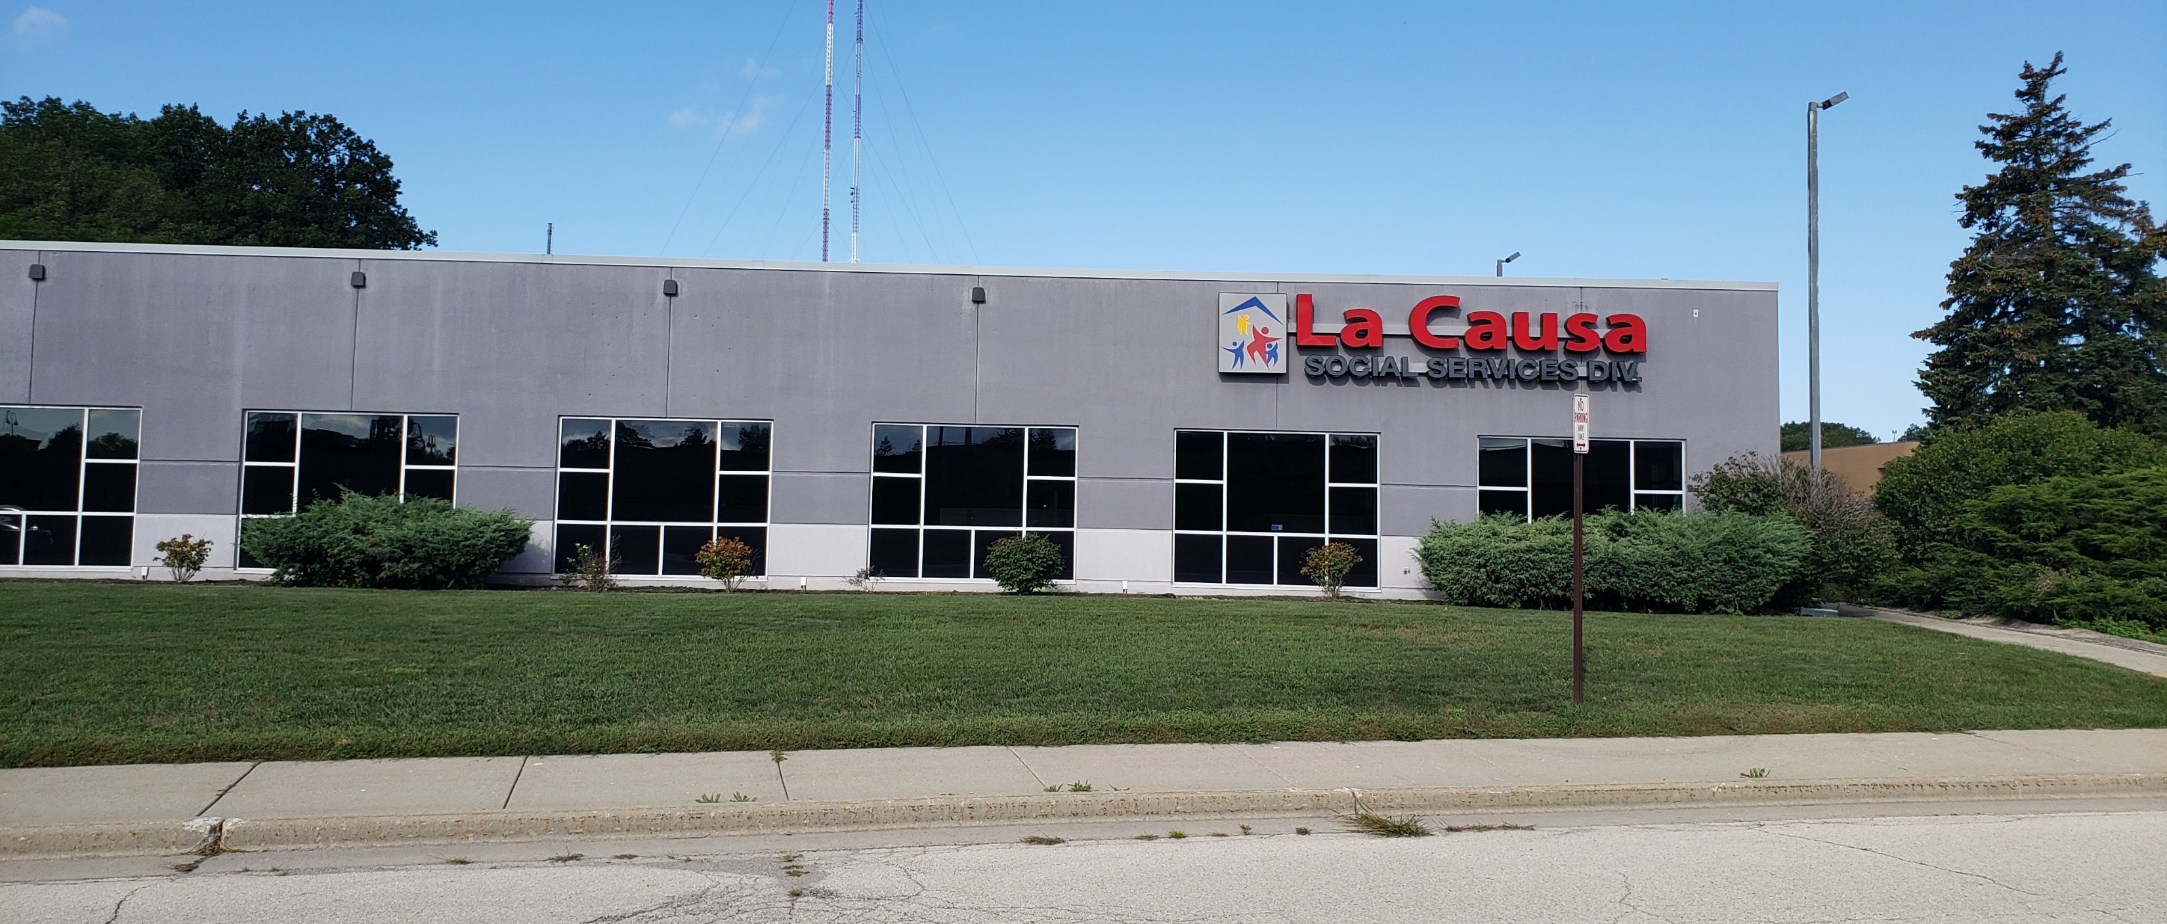
La Causa: TCM/CCM
Change of Scenery: Work in Progress

Slide 2
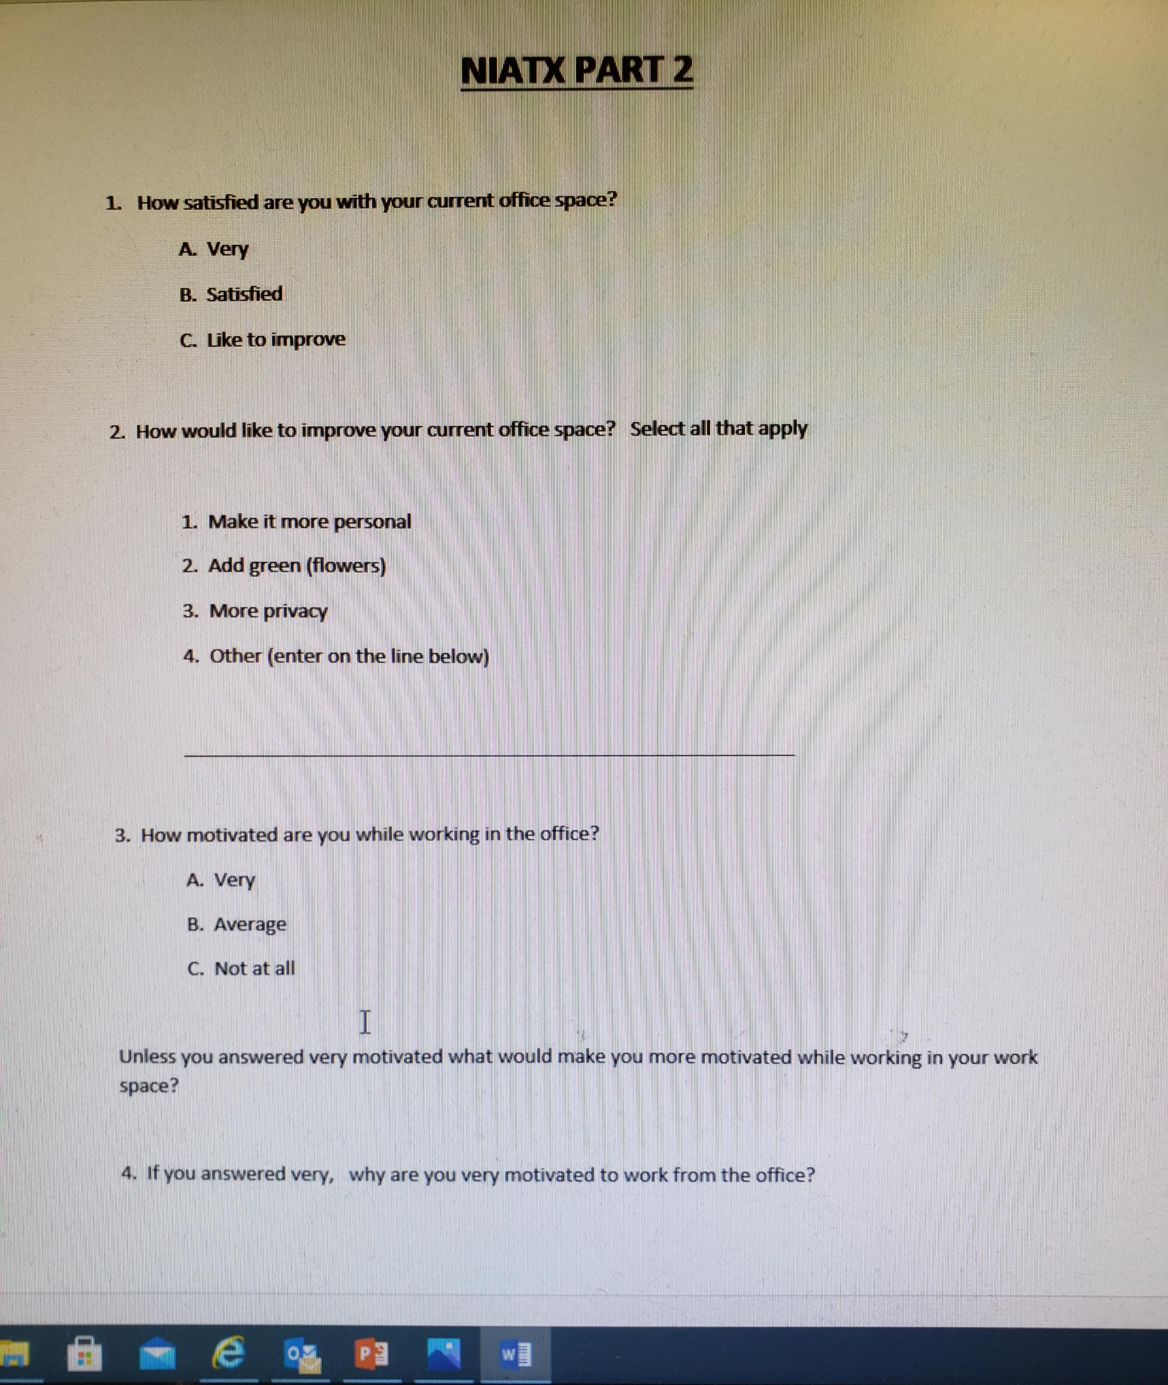
New Building :
The TCM/CCM team was forced to move from the be-loved community-based “Community Enrichment Center” or The House, to the new La Causa Social Services building in Glendale. Morale was low due to the move and COVID and missing the many consumers we had seen on a weekly basis.

Slide 3
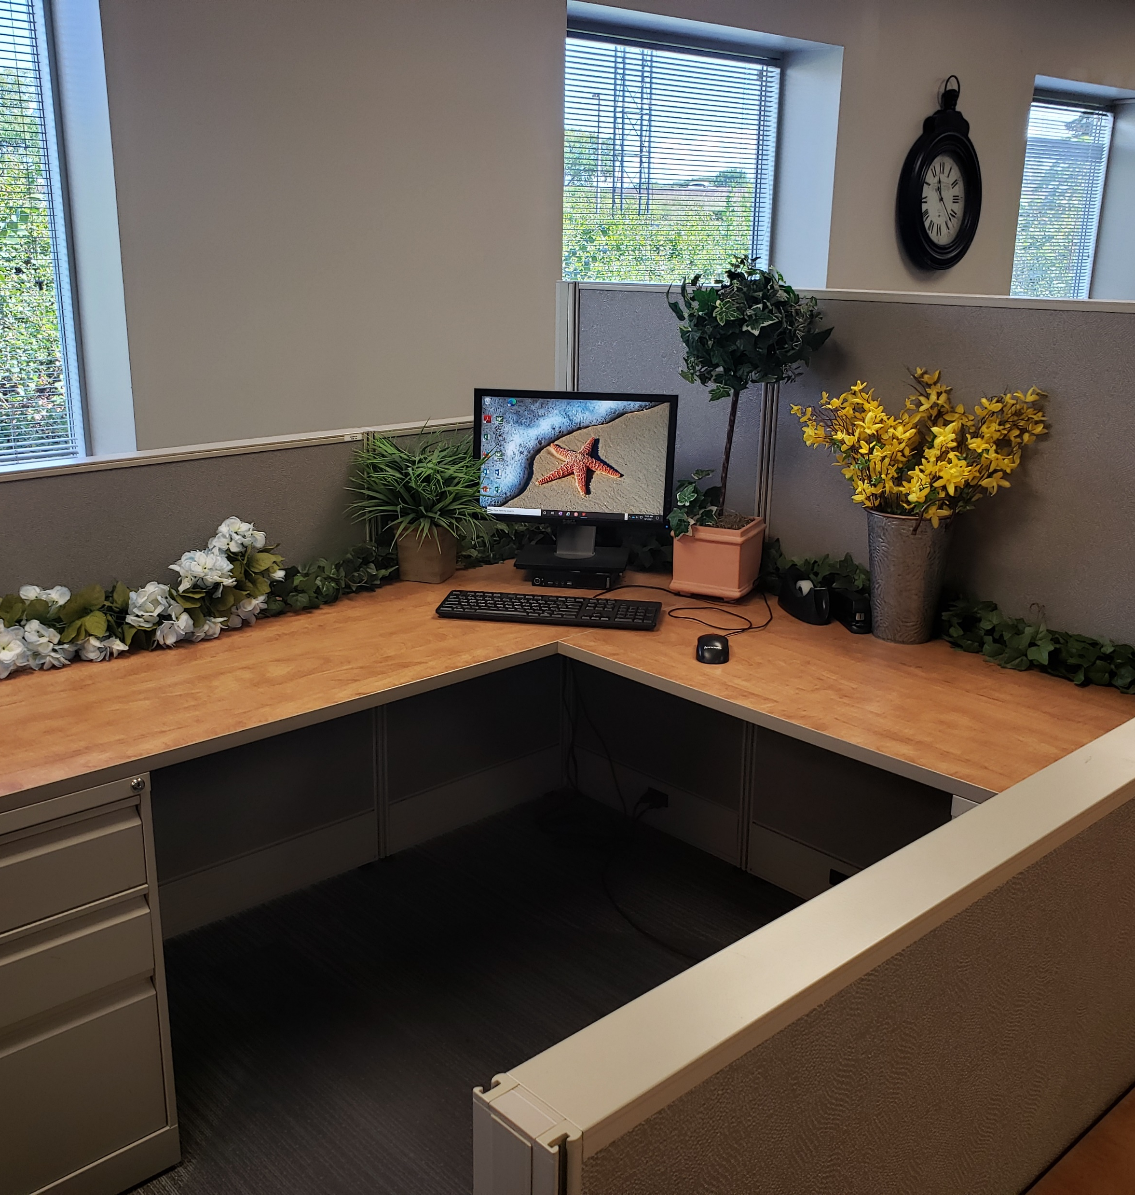
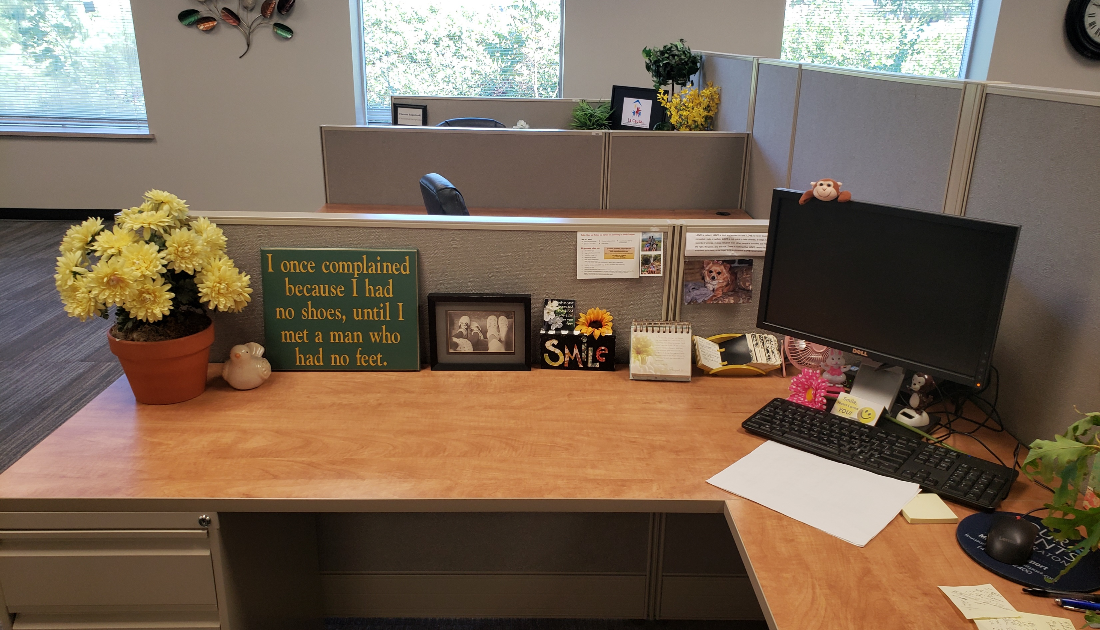
RESULTS:
Most of the Team wanted to improve their work areas. Many wanted more privacy, and/or to make the areas more personal and green. They wanted to add pictures or flowers to keep them motivated and build on their self-care, so they could more efficiently with their consumers. Some wanted a quiet space to work to avoid distractions. Some of the things that were wanted were already under consideration from the management staff.

Slide 4
OUTCOMES:
TCM/CCM Team placed and maintain Tier One Status through BHD
TCM/CCM Team was able to retain most of the Pre-Covid Staff
CCM Surveys: Met the required number with a higher than average approval rating.
Higher fee for service reimbursement.
Change from the original NIATX Project: Due to the consumer satisfaction levels
TCM Surveys: Met required number with a higher than average approval rating

Slide 5
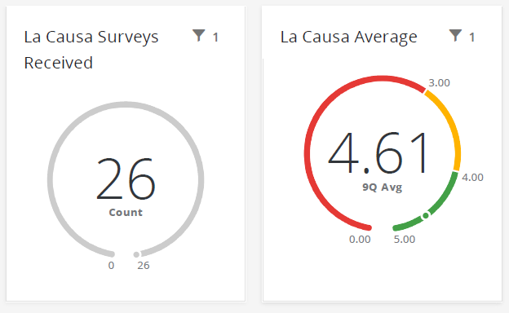
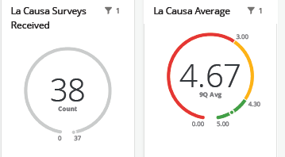
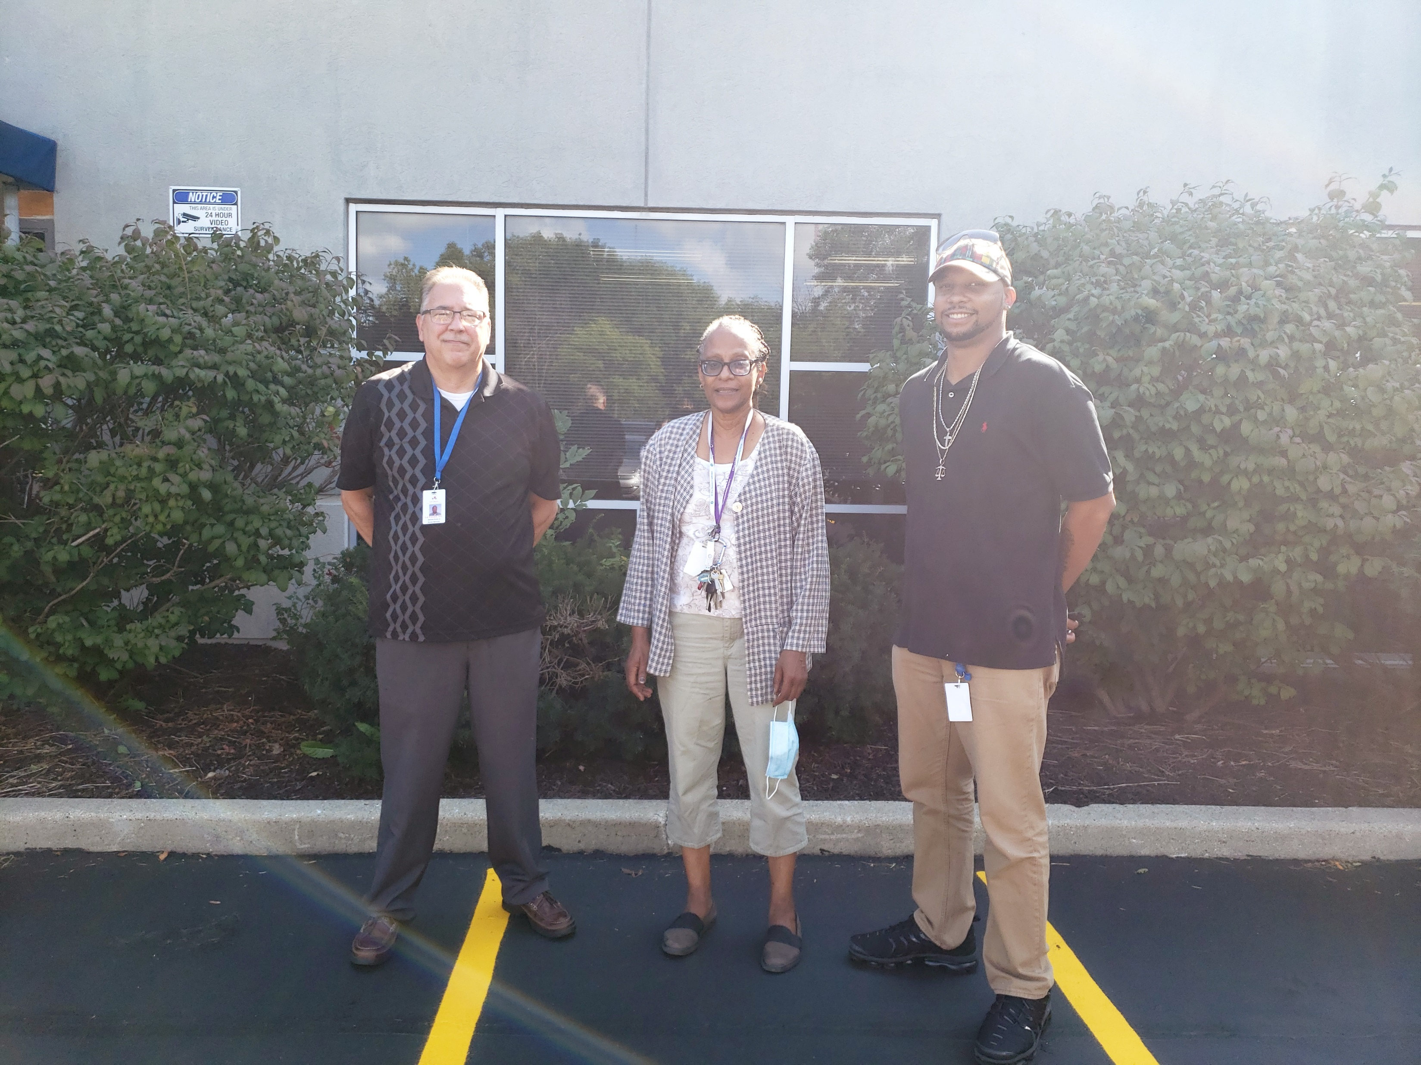
Outcome Data:

