Slide 1
Climbing Tiers
PSG: Moving from CCS Tier 2 to Tier 1

Slide 2
Change Team
CCS Care Coordinators
MHP/SAP
CCS Admin
PSG Clinical Director

Slide 3
Aim
Move to CCS Tier 1 by more accurate, complete, and timely documentation and assessments

Slide 4
Change
Updated 6-month and annual checklists to include frequently missed tasks that have previously led to denials on submitted plans. Checklists are required to be completed by the CC and signed off by the MHP/SAP and admin. New checklists were implemented in April.
Target: to decrease initial plan denials from CCS county admin

Slide 5
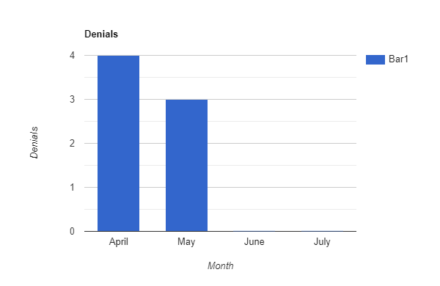
Data
April = 4 denials
May = 3 denials
June = 0 denials
July = 0 denials
**ended in July because we were awarded tier 1 status at the end of the month

Slide 6
Impact
Care coordinators have made these changes in the checklist as part of their routine for completing plans. Plans are completed in a more accurate and complete manner.

Slide 7
Next steps
Train new staff with these new checklists and ensure that all staff are often reminded of the process needed to complete plans

