Slide 1
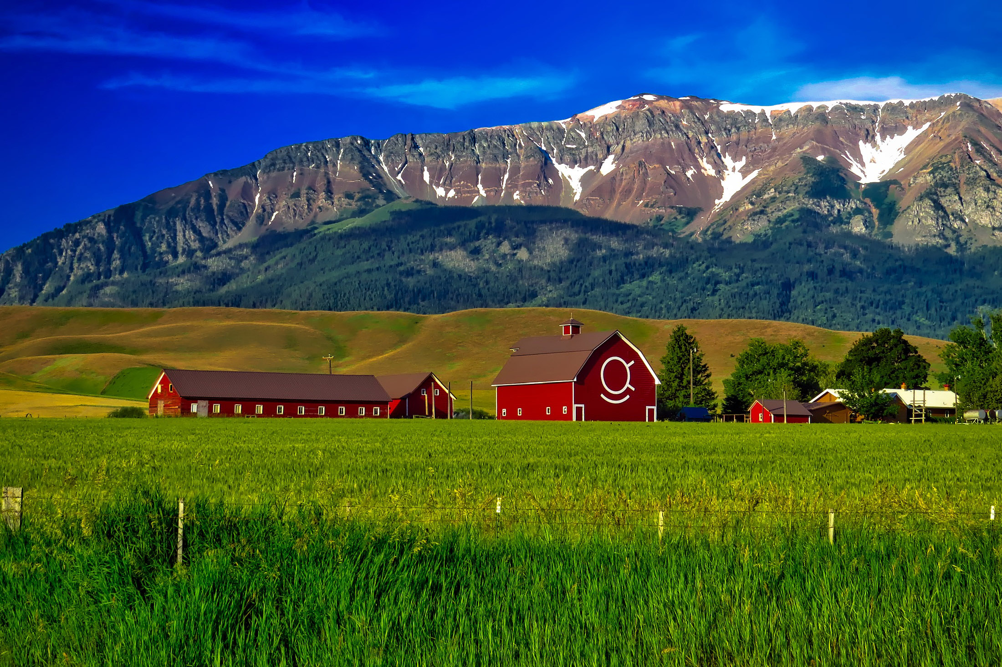
Here an appointment, there an appointment, everywhere an appointment, appointment

Slide 2
AIM
The Change team, Charmaine, Amy, JoNeesha, Sara, Belinda, Kari and Pat wanted to see if the clients were getting the appointment times they needed. With more people returning to work would we need to open more evenings appointments?

Slide 3
Measure
When a client called to schedule an appointment we used a very scientific technique to collect the data. We used hash tags on a piece of paper. We had the day broken down from 9:00am to 12:00pm, 12:00pm to 4:00pm and 4:00pm to 7:00pm. We collected the data from July 1, 2022 to July 31, 2022

Slide 4
Results
The results are in, In the category of 9:00am to 12:00 pm 44.1% of the clients preferred this time frame. In the category of 12:00pm to 4:00pm 44.2% of the clients preferred this time frame 12 to 4 and in the final category of 4:00 pm to 7:00pm 9.5% of the clients preferred this time frame.

Slide 5
Abandon
The judges have been in discussions for a long time.
Wait they have a decision.
EVERYONE GETS A BLUE RIBBION.
Due to being able to offer telephonic assessments, evenings are not being request more for appointments.

