Slide 1
Hot In Here!
Guest House of Milwaukee: Increasing the frequency of WIRT implementation by CCS Case Coordinators

Slide 2
Change Team
CCS Care Coordinators
CCS Supervisor
CCS MHP/SAP
QA Auditor
CCS Director

Slide 3
aim
Increase the frequency of Wisconsin Recovery Thermometer (WIRT) implementation by CCS Case Coordinators as documented in Provider Connect.

Slide 4
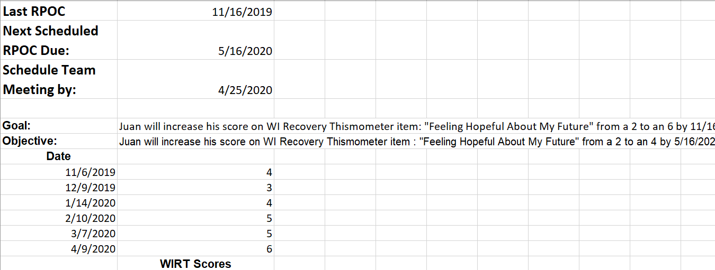
change
CC’s identified use of tracking tool via consensus. It was distributed and trained to in March. Implemented effective April 1.
Target: Increase the frequency of Wisconsin Recovery Thermometer (WIRT) implementation by CCS Case Coordinators as documented in Provider Connect by 25% to 75% overall

Slide 5
Results
Pre-test
Post-test
(Includes only Consumers enrolled in all 4 months)

Slide 6
Next steps: Adapt
Improvement made
More is needed
Improvement was made (14%) but the goal was not met (25%).
Add reminders from tickler to calendar.

Slide 7
impact
Evaluation
Sustainability
Data confounds include:
Staff turnover (1) & vacancies (2)
Staff delay in implementation (1)
Staff office relocation – all
Delays in discharging disengaged consumers
Increase in consumer meeting cancellations
Hire and train new staff
Increase individual staff oversight& accountability for implementation
Continue to identify and discharge or re-engage consumers in a timely manner
Add reminders based off tickler report to calendar
Sustainability con’t
Sustain leader: Linsey
Monitoring: Andrea
Executive Sponsor: Samella

