Slide 1
Learning Ideas For Enduring
2016 CARS system-wide NIATx Project

Slide 2
Deaths of Clients in MCBHD CARS Services
January, 2016

Slide 3
Age at Death – Measures of Central Tendency – 770 Clients 2002 – 2014
Average Age of Death in MKE County:
Males = 74.5 Females = 79.7

Slide 6
Percent Reporting “Severe,” “Extreme,” or “Catastrophic” Stress at Last RAP

Slide 7
High Stress Over Time (5 RAP Period) – Deaths Not Disaggregated Due to Homogeneity Among Causes

Slide 8
GAF Scores Over Time (5 RAP Period)

Slide 9
“No Activity” Over Time (5 RAP Period)

Slide 10
“New Symptoms” or “Unstable” Health Status Over 5 RAP Period

Slide 11
Relationship of “New Symptoms” or “Unstable” Health Status to Inactivity

Slide 12
Multivariate Results – 6170 Clients Alive and Deceased of Natural Causes
Omnibus Testª
Likelihood Ratio Chi-Square | df | Sig.
156.038 | 4 | .000
Dependent Variable: FinalMannerTripartite Model: (Intercept), StressRecode1, HealthStatus1, Activity1, RAP_AXIS5.1
a. Compares the fitted model against the intercept-only model.
Parameter Estimates
Parameter | B | Std. Error | 95% Wald Confidence Interval |  | Hypothesis Test |  |  | Exp(B) | 95% Wald Confidence Interval for Exp(B)
 |  |  | Lower | Upper | Wald Chi-Square | df | Sig. |  | Lower | Upper
(Intercept) | 1.353 | .1999 | .961 | 1.745 | 45.787 | 1 | .000 | 3.869 | 2.614 | 5.724
[StressRecode1=1.00] | .462 | .1336 | .200 | .724 | 11.961 | 1 | .001 | 1.587 | 1.222 | 2.062
[StressRecode1=2.00] | 0ª | . | . | . | . | . | . | 1 | . | .
[HealthStatus1=1.00] | 1.309 | .1281 | 1.058 | 1.560 | 104.418 | 1 | .000 | 3.702 | 2.880 | 4.758
[HealthStatus1=2.00] | 0ª | . | . | . | . | . | . | 1 | . | .
[Activity1=1.00] | .402 | .1216 | .164 | .641 | 10.961 | 1 | .001 | 1.495 | 1.178 | 1.898
[Activity1=2.00] | 0ª | . | . | . | . | . | . | 1 | . | .
RAP_AXIS5.1 | .000 | .0043 | -.009 | .008 | .001 | 1 | .970 | 1.000 | .991 | 1.008
(Scale) | 1^{b}
Dependent Variable: FinalMannerTripartite Model: (Intercept), StressRecode1, HealthStatus1, Activity1, RAP_AXIS5.1
a. Set to zero because this parameter is redundant.
b. Fixed at the displayed value.

Slide 13
Figure 3. Estimated prevalence of poor self-rated health during the 12 years prior to death in deceased cases and surviving controls by age groups (men and women).
Stenholm S, Pentti J, Kawachi I, Westerlund H, Kivimäki M, et al. (2014) Self-Rated Health in the Last 12 Years of Life Compared to Matched Surviving Controls: The Health and Retirement Study. PLoS ONE 9(9): e107879. doi:10.1371/journal.pone.0107879
http://127.0.0.1:8081/plosone/article?id=info:doi/10.1371/journal.pone.0107879

Slide 14
Self-Rated Health – Early Identification of at Risk Individuals CARS Comprehensive Assessment

Slide 15
Charlson Comorbidity Index
As Comorbidities Expected Mortality
Charlson Comorbidity Calculator
http://www.pmidcalc.org/?sid=7722560&newtest=Y#6

Slide 16
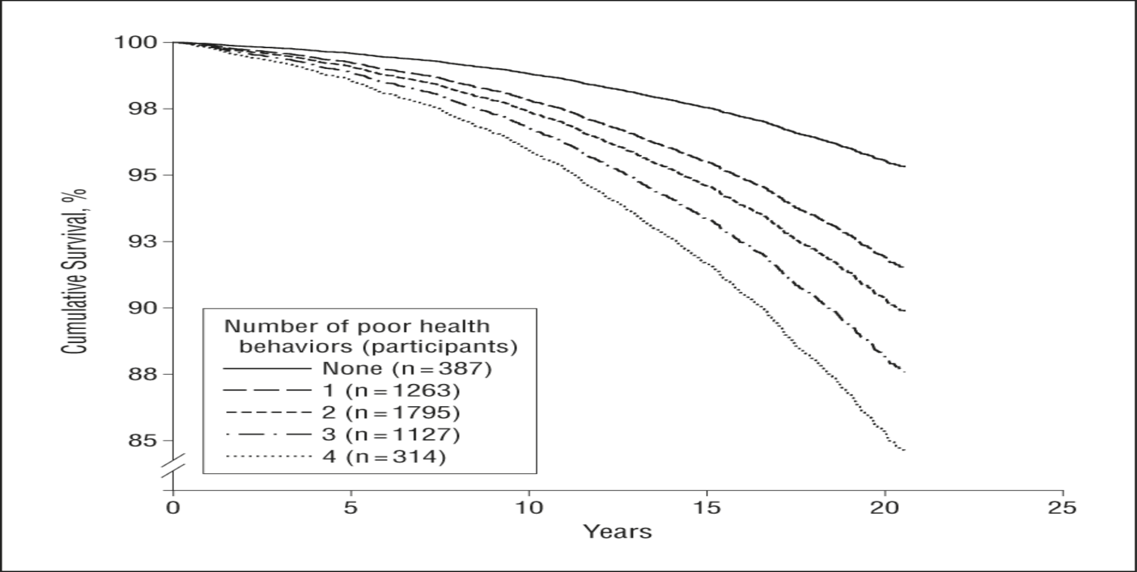
From: Influence of Individual and Combined Health Behaviors on Total and Cause-Specific Mortality in Men and Women: The United Kingdom Health and Lifestyle Survey
Arch Intern Med. 2010;170(8):711-718. doi:10.1001/archinternmed.2010.76
Survival function by number of poor health behaviors in 4886 men and women 18 years or older, adjusted for age, sex, occupational social class, body mass index, blood pressure, and prior illness. Health and Lifestyle Survey, 1984-1985 to 2005.
Date of download: 8/3/2015
Copyright © 2015 American Medical Association. All rights reserved.

Slide 17
Disease Categories and Risk Factors for Early Morbidity/Mortality Among Those with SPMI
Disease
Cardiovascular disease – Most prevalent cause of death
Cancer
Pulmonary Disorders
Metabolic Disorders
Diabetes
Metabolic syndrome (abdominal obesity, elevated blood pressure, dyslipidemia, insulin resistance, etc.)
Risk Factors
Lifestyle (Sedentary lifestyle; poor diet)
Smoking
Antipsychotics
Obesity
Others
Depression – predictor of poorer outcomes in CVD and diabetes – severity dependent
Quality of Life
Substance use

Slide 18
Four Key Areas of Focus
Metabolic syndrome
Nutrition
Smoking Cessation
Physical Activity

Slide 19
Learning Ideas For Enduring
2016 CARS system-wide NIATx Project

Slide 20
O’Donnell
D
I
A
N
E
Metabolic

Slide 21
Johansen
Nutrition & Health: Fundamentals & Resources
L
A
R
R
Y
(414) 257-7643 or laurence.johansen@milwaukeecountywi.gov

Slide 22
Learning Objectives…
What is Nutrition.
Why is Nutrition important?
What do we teach clients?
What are 2 nutrition resources?

Slide 23
Nutrition: the Basics…
Eat 3 Meals a Day…Don’t Skip!!
Eat 3-4 Ounces Protein-rich Foods Every Meal.
Decrease/Eliminate Soda & Juice
Careful with Starch and Grains
Relax when you eat

Slide 24
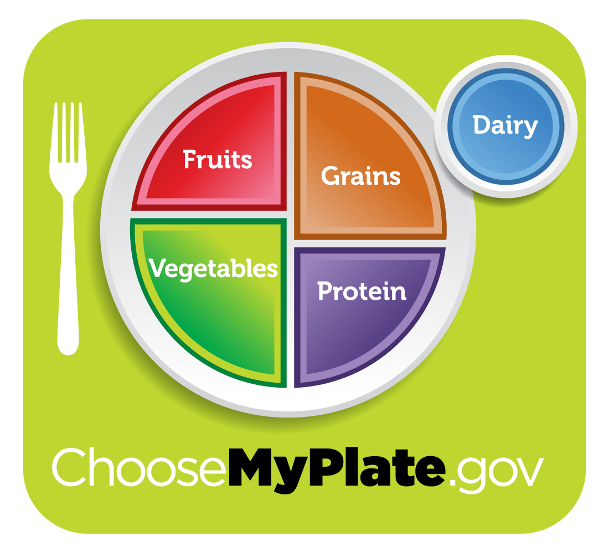
Starches &

Slide 25
Notes:
Welcome
Have Group Introduce Selves and Why They Came (size allowing)
Introduce Self & Background Leading to ZONE
Individual Counseling and Classes on Nutrition, Attunement & Stress Management
25 years experience
How I found The ZONE

Slide 26
Camel Theory of Disease
How many straws can you put on the camel’s back?
How about “the straw that broke the camel’s back”?

Slide 27
STRESSORS
Are the straws, leaves, twigs, branches and LOGS on the Camel’s back

Slide 28
Stressor Types
Two Broad Categories:
Emotional
Physical

Slide 29
Foundation Care
Managing Stress
Managing Diet
Managing Exercise
Managing Appropriate Dietary Supplements

Slide 30
What is Nutrition?
Ingestion
Digestion
Assimilation
Utilization
Growth
Repair
Metabolism
FOOD

Slide 31
What is Food? Macronutrients:
Protein
◉
Carbohydrate
◉
Lipids
H₂O

Slide 32
Protein
BUILDING MATERIALS
Animal derived and Soy and Lentils
Composed of Amino Acids
Structure & Enzymes
Structural Materials & Worker Bees
Essential Amino Acids: ~9
Excess will convert to Sugar

Slide 33
Carbohydrates
ENERGY
Plant derived
Sugars: mono- and di-saccharides
Starch: long chains of sugar that digest quickly and easily
Fiber: long sugar chains that do NOT digest
Excess ENERGY converts to STORED ENERGY…

Slide 34
Lipids (Fat)
STORED ENERGY (generally)
Come from plants and animals
Fatty acids: oils and fats
Essential Fatty Acids

Slide 35
Test Time…
Define Nutrition.
List the major components of food and their role in metabolism.
Discuss how diet can impact healthcare, either to promote health or inhibit health.

Slide 36
Resources…
Good and Cheap by Leanne Brown http://www.leannebrown.com
ChooseMyPlate Daily Tips http://content.govdelivery.com/accounts/USDACNPP/bulletins/1307c5e
Farmers Markets http://www.farmfreshsewi.org/index.htm
Wisconsin Food Manager Certification https://www.dhs.wisconsin.gov/fsrl/certificates.htm
Food Handling and Management https://www.servsafe.com/home

Slide 37
Be Proactive… Model Healthy Behavior!!

Slide 38
Remember:
No Free Lunch!
☺

Slide 39
B
R
E
A
K

Slide 40
Gorilla
Behavioral Health & Tobacco Dependence Treatment
A
L
L
I
S
O
N
Outreach Specialist, University of Wisconsin-Center for Tobacco Research and Intervention

Slide 41
Behavioral Health and Tobacco Dependence Treatment
Allison Gorrilla, MPH Outreach Specialist
University of Wisconsin-Center for Tobacco Research and Intervention

Slide 42
Learning Objectives:
Explain the benefits of treating dependence tobacco as part of comprehensive, individualized behavioral health treatment planning
Understand how you can utilize evidence-based tobacco dependence treatment integration strategies to help people quit and remain quit
Identify the aim, work, and resources of WiNTiP - Wisconsin Nicotine Treatment Integration Project (HelpUsQuit.org)

Slide 43
Smoking Prevalence Among Adults 18 and Older, United States, 1965-2012
2014 = 17.8%

Slide 44
Prevalence of Nicotine Dependence in Co-Occurring Disorders
Tobacco use of individuals with mental heath/substance use disorders continue to smoke at high rates - about 41%
Individuals living with behavioral health conditions are dying up to 25 years earlier than the general population
Often due to tobacco related diseases – cancer, heart disease, lung disease
More likely to die from this disease than from their drug and/or alcohol use
This population consumes 45% of cigarettes smoked

Slide 45
Prevalence of Nicotine Dependence in Co-Occurring Disorders

Slide 46
Prevalence of Nicotine Dependence in Co-Occurring Disorders

Slide 47
Perceived and Real Barriers to Treatment
History of tobacco us in mental health and addictions treatment
Perceptions that quitting smoking will worsen mental health recovery
Tobacco is necessary self-medication for the mentally ill
Concern that smoking cessation will interfere with abstinence from other substances
Perception that those with mental illness/SUD are not interested or able to quit

Slide 48
Rationale for Nicotine Dependence Treatment
As likely as the general population to WANT quit.
More intensive, tailored treatment is needed, but MI/SUD tobacco users can quit
Concurrent treatment works
Enhances long-term abstinence from alcohol and drugs
Cessation improves depression, anxiety, and reduces stress
Immediate health benefits and long term impacts on quality and quantity of life
Clinical approaches in behavioral health treatment are applicable to tobacco treatment

Slide 49
“Tobacco use is just another addictive substance. Everything we do to help people get off alcohol and drugs works for tobacco too. At the end of the day, we’re helping clients live healthier, longer lives.”
Erik Stone, MS CACIII, Director of Compliance and Quality Improvement, Signal Behavioral Health Network

Slide 50
What are Evidence-Based Nicotine Dependence Treatments?
Clinical Practice Guideline: Treating Tobacco Use and Dependence
Effective tobacco dependence treatments consist of:
Brief clinician coaching/counseling
One of the 7 FDA-approved medications
Systems-level changes that institutionalize cessation treatment

Slide 51
The 5 A’s for a Client/ Patient Willing to Quit
ASK all clients/patients about their tobacco use
ADVISE all smokers to quit
ASSESS willingness to make a quit attempt
ASSIST in quitting attempt (counseling & meds)
ARRANGE for follow-up

Slide 52
Counseling
5 Key Points for the Smoker Willing to Make a Quit Attempt:
Set a quit date: ideally within 2-3 weeks
Review past quit experiences
Seven (7) FDA-approved medications for cessation
Discuss patient concerns
Anticipate challenges to the upcoming quit attempt
Other smokers in the household
Alcohol

Slide 53
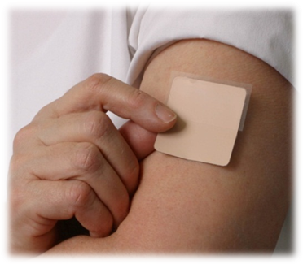
Counseling + Medications = Success
Seven FDA-Approved Medications for Tobacco Dependence
Bupropion SR
Nicotine gum
Nicotine inhaler
Nicotine nasal spray
Nicotine patch
Nicotine lozenge
Varenicline

Slide 54
Treatment Considerations
Determine need for involvement from primary care/other health care provider
Determine need for more intensive behavioral therapy
Address psychotropic medication issues
Tailor treatment plan based on:
Current stability of symptoms/recovery
Functional status
Previous quit history
Help develop a quit plan
Most people do better if they get help to PREPARE and PLAN for their quit attempt
Provide practical counseling
Most people do better if they understand the need to change behavior too
Provide social support
People who get help and social support are more likely to be successful in quitting smoking

Slide 55
Counseling
Tobacco Intervention for the Smoker
Not Willing to Make a Quit Attempt:
Motivational Interviewing
Explore and help resolve ambivalence about change
Elicits “change talk”
Guides clients to their own decision making
Increase self-efficacy for change
Empowers clients to choose change
“There is a treatment that may help you reduce your smoking.”
Deliver a smoking reduction + nicotine replacement therapy (NRT) treatment for those willing to try it: for up to 6 months pre-quit (patch, gum, or inhaler)

Slide 56
Congratulate success and encourage person to remain abstinent
Use relevant, open-ended questions to discover whether the person wishes to discuss issues related to quitting:
The benefits the person derived from cessation
Any success they have had in quitting (duration of abstinence, reduction in withdrawal, etc.)
The problems encountered--or anticipated threats--to maintaining abstinence (e.g., depression, weight gain, alcohol, other tobacco users in the household, significant stressors)
A medication check-in, including effectiveness and adherence
It’s important to support multiple quit attempts as part of the process
And it’s important to encourage the person to keep trying

Slide 57
The Wisconsin Tobacco Quit Line
Phone-based program, web-based support
Available 24 hours a day, 7 days a week
Offers free, confidential coaching on how to quit tobacco
Coaches tailor counseling to the individual
Translators available in virtually any
language
Spanish Line: 1-877-2NO-FUME
(266-3863)
TTY telephone line: 1-877-777-653

Slide 58
What services are available?
Quit Coach calls
Nicotine Replacement Therapy starter kit
Online Web Coach feature
Quit Kit: self help materials
Information for Others
Referrals to local quit-tobacco programs and services

Slide 59
Fax to Quit
Easy way to connect patient to Quit Line
Fax consent form to Quit Line
Quit Coach proactively calls patient
Clinician/treatment specialist is kept in the loop
Increases/improves access to cessation resources

Slide 60
Wisconsin Nicotine Treatment Integration Project (HelpUsQuit.org) Resources
Tobacco treatment training and technical assistance
Website
Resources (videos, toolkits, posters, webinars, etc.)
Research and literature

Slide 61
Wisconsin Residents
Share Their Stories….

Slide 62
My contact information
Allison Gorrilla, MPH
Outreach Specialist
University of Wisconsin-Center for Tobacco Research and Intervention
1218 W Kilbourn Ave St. 501
Milwaukee, WI 53233
agorrilla@ctri.wisc.edu
414-333-3067
Ctri.wisc.edu

Slide 63
Malloy
J
O
Y
Active Lifestyles

Slide 64
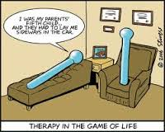
L
U
N
C
H

Slide 65
Navigating Your Way Through Continuous Quality Improvement January 26, 2016

Slide 66
What is NIATx?

Slide 67
A NIATx History: The Four Aims
NIATx promotes systems change and innovation with a focus on four aims:
Reduce waiting time
Reduce no-shows
Increase admissions
Increase continuation

Slide 68
The Five Principles
Five key principles guide the NIATx model:
Understand and involve the customer.
Fix key problems; help the CEO sleep.
Pick a powerful Change Leader.
Get ideas from outside the organization or field.
Use rapid cycle testing to establish effective changes.

Slide 69
Which of the 5 key principles do you think NIATx says is the most important?

Slide 70
The Walk-Through
One of the best ways to understand your
customer is to walk through the process
of getting services as they do.
Who completed a walk-through?
What was it like?
Any interesting observations?
Any ideas or sparks for a change project as a result of the walk-through?

Slide 71
The NIATx Way

Slide 72
Step by step… you will get there.
Consider a NIATx aim. (We have that done already!)
Define a change project.
Appoint a Change Leader.
Appoint a Change Team.
Allocate sufficient resources.
Monitor progress.
Perform a walk-through.

Slide 73
Step by step…you will get there. (cont.)
Select a project aim.
Measure baseline data.
Select a change idea to test.
Test changes.
Increase financial strength.
Sustain improvements.
Tell your story.
Select the next NIATx project.

Slide 74
Measure Baseline Data
Measuring baseline data allows you to answer the question: How will we rapidly know a change is an improvement?
Define a starting point for change and work backwards to collect baseline data before making any changes.
Create a data collection plan: who, when, how?
Collect data on a regular basis.

Slide 75
Selecting a Change Project
We know the aim is to “improve health outcomes for the people we serve” in each program.
Nominal Group Technique Exercise?
Silent idea generation, round robin recording of ideas, discussion, preliminary vote, discussion, final vote
Lg group: do steps 1-4 in smaller groups, then convene as larger group

Slide 76
Test Changes
Use the “PDSA” Cycle to rapidly test and refine changes.
Plan the change
Do the plan
Study the results
Act (Adopt, Adapt or Abandon)

Slide 77
PDSA
PDSA uses a series of short rapid cycles, where the goal is to test a particular change on a small scale, learn what you can, and get better in the next application.
The results of each change cycle are compared to pre-test measurements to ensure the change is actually an improvement.
Only when the change cycles results in an improvement in the existing process is the change fully implemented.

Slide 78
PDSA (cont.)
By using PDSA, you:
Minimize risks and expenditures of time and money.
Make changes in a way that is less disruptive to clients and staff.
Reduce resistance to change by starting on a small scale.
Learn from the ideas that work, as well as those that do not.

Slide 79
PDSA Exercise

Slide 80
Charter Document
With your Change Team, work on your charter document.

Slide 81
A Word or Two from a Special Player…
Now that you have done all this work and you are headed in the right direction… here is an example of a finished product!

Slide 82
Your Next Moves
Solidify your internal change team – and start meeting regularly!
Send one representative to each monthly NIATx meeting
Mark your calendars now for the NIATx Storyboard Event – 8/17/16

Slide 83
For Roadside Assistance…
NIATx:
Janet.Fleege@milwaukeecountywi.gov
Amy.Moebius@milwaukeecountywi.gov
Jennifer.Wittwer@milwaukeecountywi.gov
Data:
Walter.Drymalski@milwaukeecountywi.gov
Michael.Nunley@milwaukeecountywi.gov

Slide 84
OK…START

