Slide 1
Making Stronger ConeXiones
2020-2021
Milwaukee, WI

Slide 2
AIM
STATEMENT
Improve clinicians’ skills and confidence related to hosting virtual and individual group therapy sessions on WebEx.
Collect Baseline Data:
Clinicians fill out pre-survey on confidence and knowledge of WebEx
Analyze Data:
Clinicians need support with hosting WebEx meetings in various areas
Create and administer a training on hosting engaging WebEx groups and individual therapy
CHANGE
CYCLE
Create and administer “How to Download WebEx” handout to every new intake
Analyze post-survey data
Collect post-survey results (after waiting 1 month)
Administer post training “quiz”

Slide 3
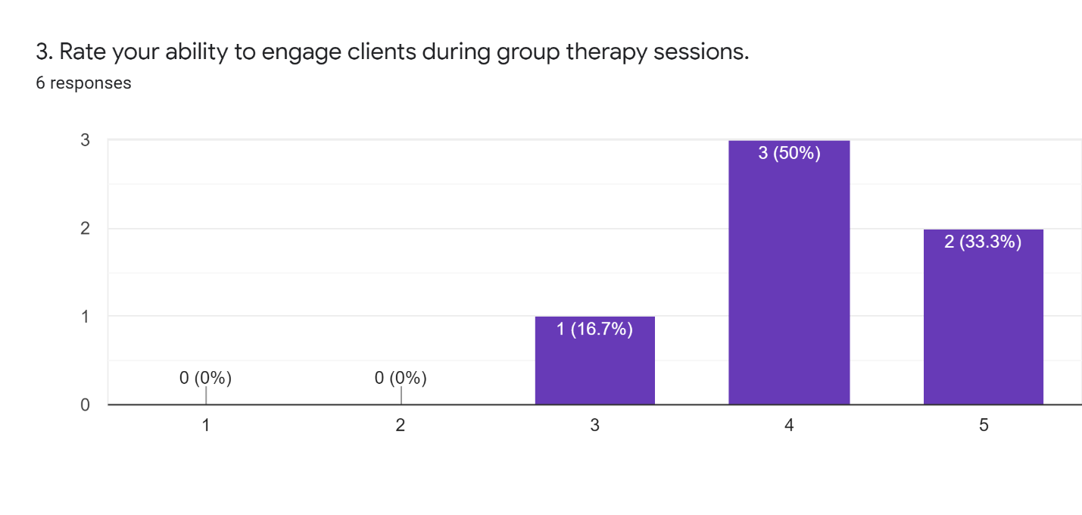
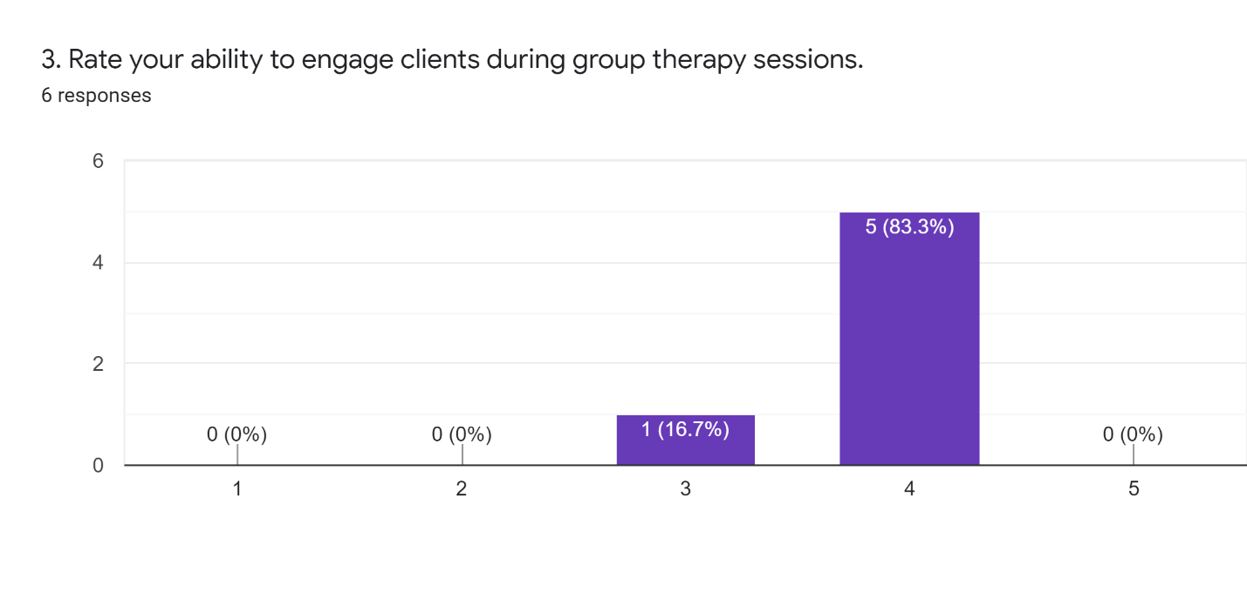
Pre-Survey Results
Post-Survey Results
Very poor Poor Fair Good Excellent

Slide 4
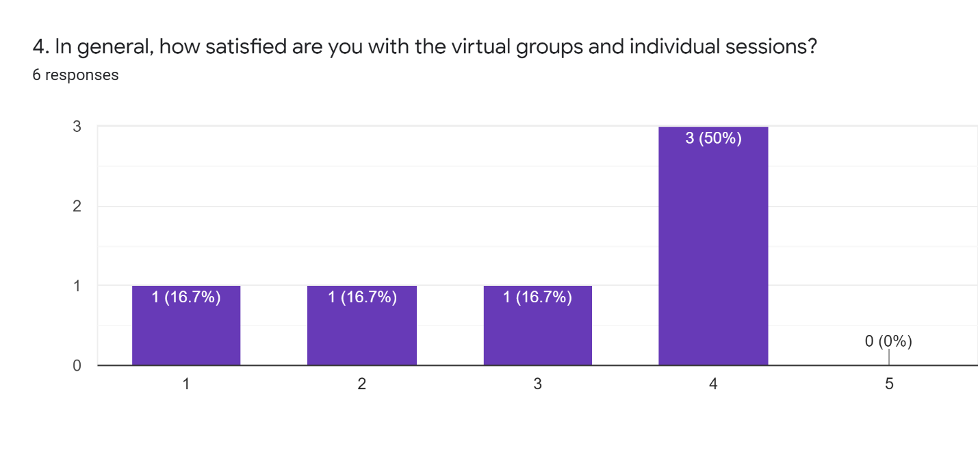
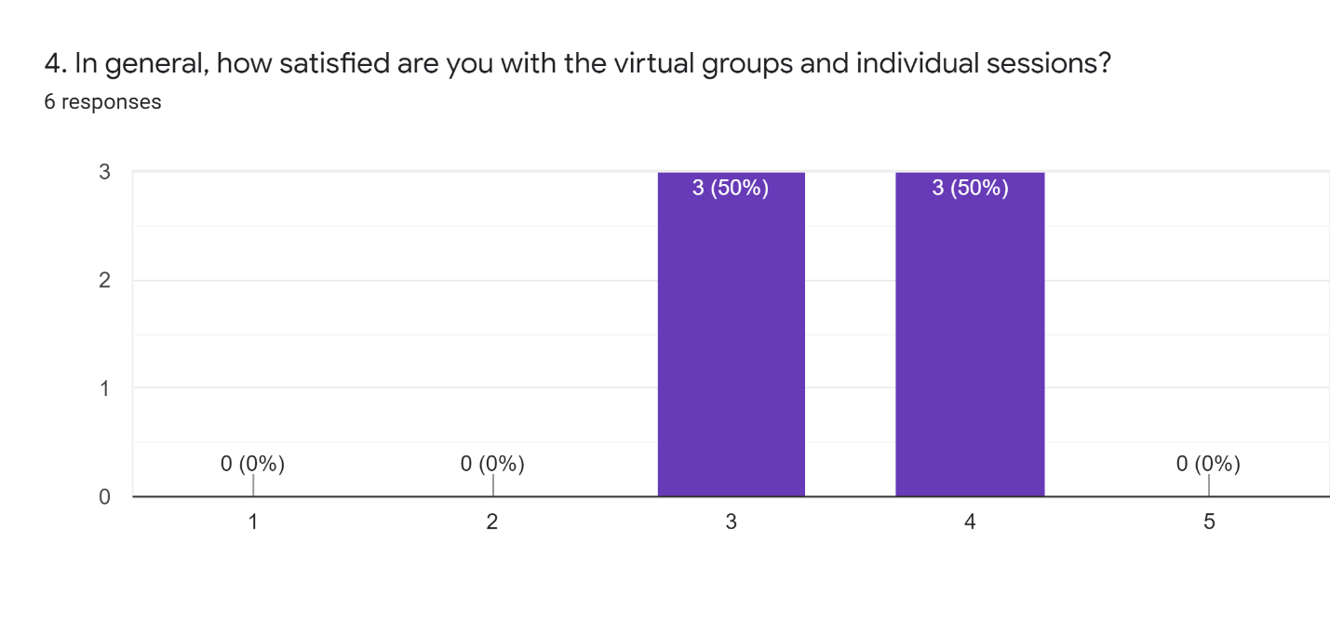
Pre-Survey Data pt. 2
Post-Survey Data pt. 2
Very dissatisfied Neutral Very satisfied Dissatisfied Satisfied
Very dissatisfied Neutral Very satisfied Dissatisfied Satisfied
What is the biggest challenge you face in hosting telehealth sessions?
“Connectivity, people coming in and out of group, distractions, auditory issues, call-in clients cannot be seen, harder to get people to engage vs. in-person sessions”
“I use the basics- I don't remove clients, nor use chat function, nor scheduling, nor using videos”
“No cameras on some clients”
What is the biggest challenge you face in hosting telehealth sessions?
“Clients having issues connecting or problems with their audio/video”
“Not seeing faces”
“Call-in clients cannot be seen or participate in polls, breakout sessions, etc.

Slide 5
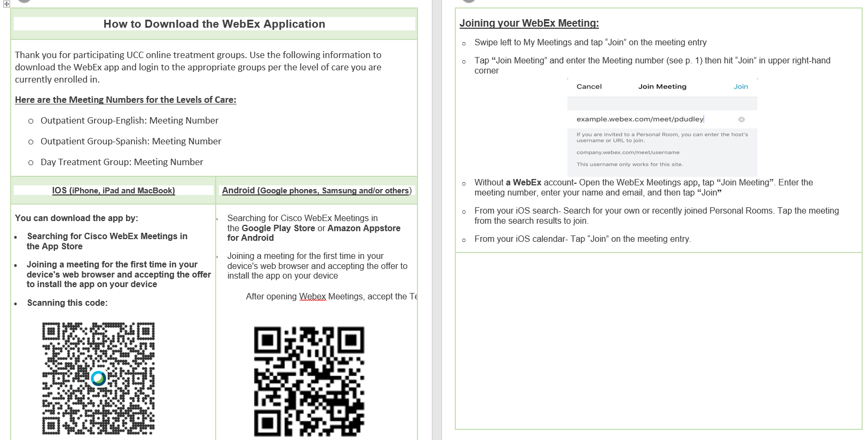
Adopt, Adapt or Abandon? Change Cycle “1.5”

Slide 6
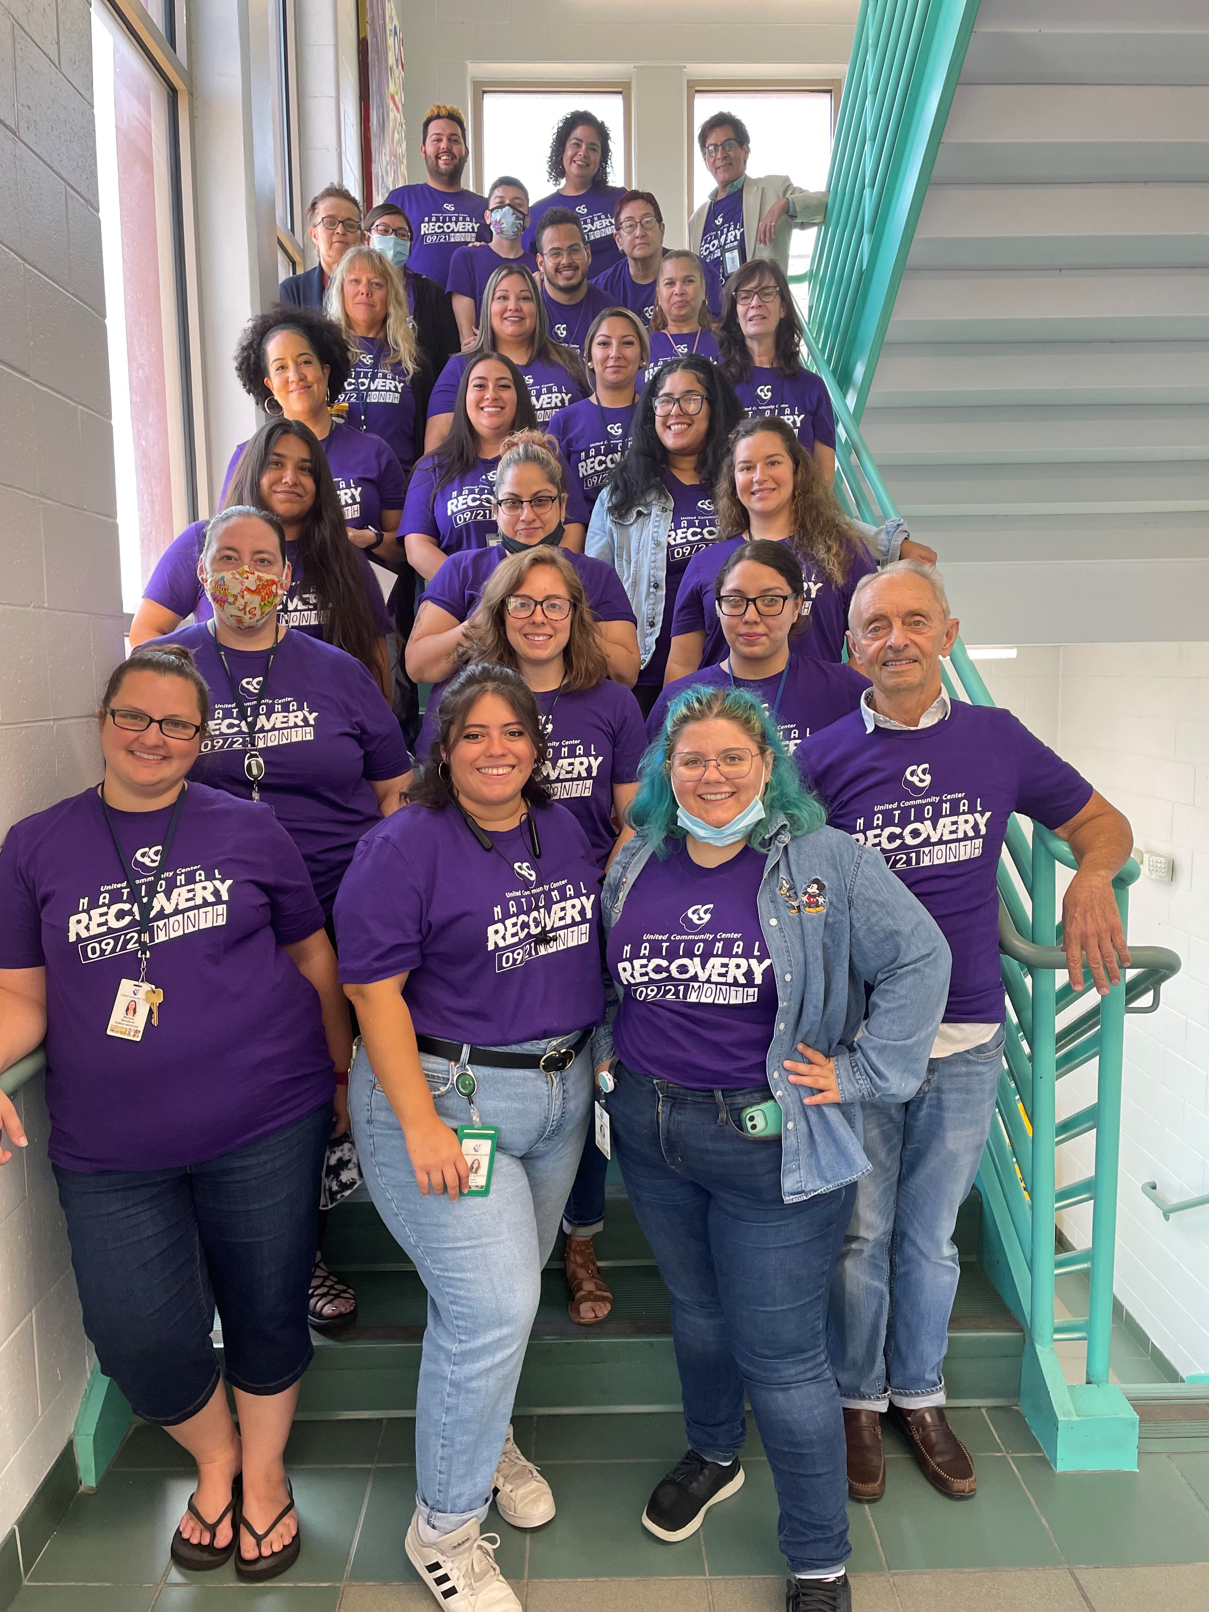
CHALLENGES OR WINS, AND FINAL AIM STATEMENT OUTCOME
Challenges:
Time constraint – UCC transitioned back to in person groups and individual therapy sessions.
If we had more time using virtual groups, we would’ve ADAPTED the project more by…
Confidence with presenting videos
Client centered training on WebEx
Wins:
Clinicians utilizing new WebEx functions more than before/overall increase in confidence
Overall increase in general satisfaction with virtual therapy
Received feedback from clinicians and created change cycle “1.5”
GOALMET?
Sort of… ☺
FINAL OUTCOME
Some successes, some room for further improvement!

