Slide 1
More Resources, Less Hassle
PRESENTATION BY: WHOLE HEALTH CLINICAL GROUP OF CFI

Slide 2
Problem
WHCG recently moved and we wanted to ensure that our waiting area was welcoming and resourceful for our consumers
Notes:
SHANTEL. Moved from one location to another

Slide 3
Survey
How satisfied are you with the current resources that Whole Health Clinical Group has available to you?
1 = Very Satisfied to 5 = Very Dissatisfied
Below is a list of different topic. Please circle ONE that is most important to you.
Listed 16 different options such as legal services, therapy, low-income housing
Low-income housing was the most requested resource with 39.02% of 41 participants
Notes:
SPENCER. Needed to gather more information, so the best way was to make up a survey and put it out in our lobby. May to June it was out

Slide 4
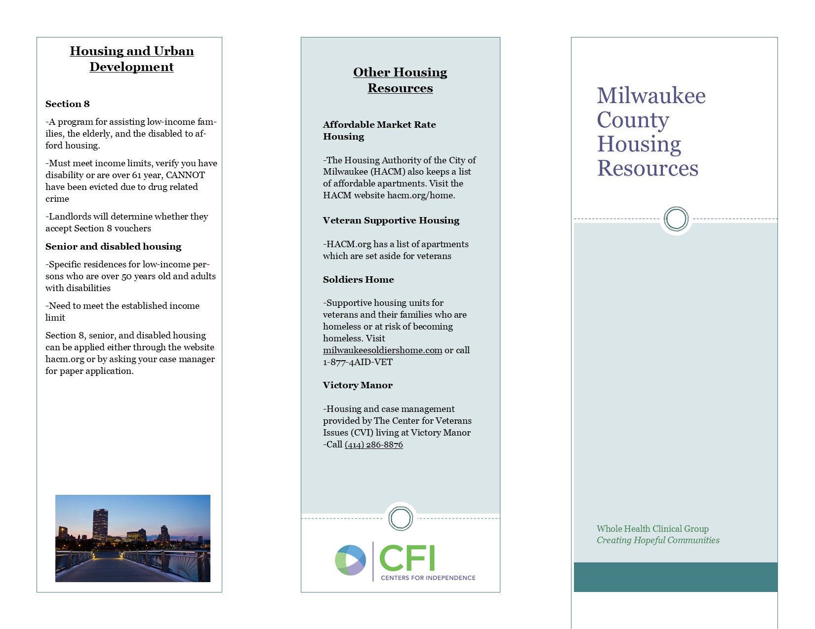
Brochure
Brochure on housing resources created and put in waiting area
Survey set out second time
Notes:
SARAH. This was our intervention, a brochure. We put it out along with the same survey from earlier in the year. Starting in early October. Our aim was that our lobby was more welcoming and resourceful due to the housing needs and that our satisfaction would go up.

Slide 5
Results
Time 2
23 participants
Dissatisfaction higher with m=2.44
Top desired resources
30.43% clothing & food pantries
26.09% legal services, low-income housing, Family Care, transportation, homeless shelters
Time 1
41 participants
Dissatisfaction lower with m=1.62
Top desired resources
39.02% low income housing
31.71% therapy
Notes:
AMY

Slide 6
Next Steps
Consider confounds
Future interventions
Time of month, time of year, and shortened data gathering phase at Time 2 could impact results
Making resources available outside of the office
Could focus more of resources for case managers
Notes:
AMY
Time 2 was in the beginning of the month, so consumers may have been more upset due to not receiving their money on time (we have a payee program)
Time 2 was a shorter time period that the survey was out.
Future interventions: making resources available to those who do not come into the office, get info to case managers to help those consumers who need extra support

