Slide 1
One Smile at a time
Sixteenth Street Community Health Center
CCS

Slide 2
Project aim
To increase the amount of SSCHC CCS consumers who are connected to a dental care provider

Slide 3
What we did
-Created updated Milwaukee Medicaid Dentist Directory organized by zip code
-Created and administered questionnaire to better understand the current needs and barriers experienced by our consumers

Slide 4
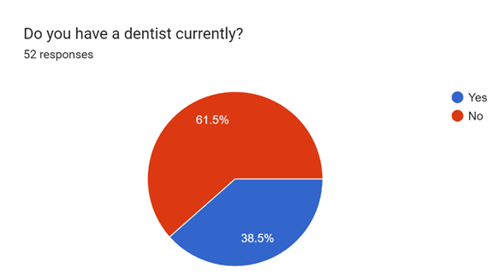
Pre survey:

Slide 5
What we learned
-83.6% barriers identified could be addressed with education or assistance
Not understanding insurance coverage, confusion around scheduling, difficulty finding dentist accepting new patients, lack of transportation
-25.5% barriers identified were mental health related
Fear/anxiety of dentists, feeling triggered, embarrassed or feeling self-conscious

Slide 6
Next steps
-Regularly check-in with consumers on if they are connected to dentist
-Continue utilizing and updating Medicaid Dentist Directory
-Continue to educate and encourage the importance of regular dental care
-Provide direct assistance in scheduling and/or getting to and from appointment

Slide 7
THANK YOU

