Slide 1
“Completion of our Person-Centered Planning (PCP) online training is the first step in learning this way of working. Developing a skillful Person-Centered Planning practice with integration into daily work requires ongoing learning, supervision, direct observation of practice, and performance-based feedback.” “Learning objectives Describe the 3Ps of the Person-Centered Planning model. Identify the four elements of the Person-Centered Planning philosophy. (Philosophy, Process, Product) Identify the five elements of the Person-Centered Planning process. Identify the three elements of the Person-Centered Planning product. Define the five essential person-centered Skills that make up Person-Centered Planning.”
Milwaukee Mental Health Associates
Person-Centered RPOCs
CSP lients surveyed for four basic perceptions of their RPOC and the RPOC process:
1) Input in all parts of RPOC and process 2)Accurately reflects client desires 3) Goals, interventions chosen collaboratively 4) Supportive and nonjudgmental
Step 1: Take Pre-Test Score and present DHS Training

Slide 2
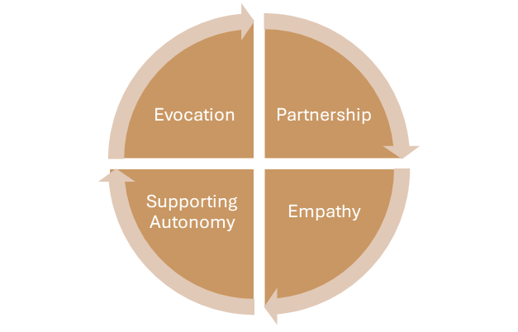
Step 2: Train Alignment of PCP Philosophy and Process (Steps) with RPOC Sections
Sections of an RPOC
Strengths
Barriers
Discharge Planning
Life Vision
Discharge Criteria
Comments
Goals
Objectives
Interventions
Engagement
Assessment
Understanding
Prioritization
Planning

Slide 3
Step 3: Teach CMs how to bring the client into the RPOC Process
Begin early and plan for sufficient time, quiet, and privacy
Schedule an ITT meeting for the RPOC well prior to putting anything in writing.
Use your Listening, Asking, Affirming, Informing (with PERMISSION) and Supporting Autonomy skills to evoke authentic participation from your client
Use the RPOC event to affirm accomplishments, positive changes, good decisions, and to elicit direction from the client as to what would be meaningful objectives for them
Make at least two statements asserting your SUPPORT for the client’s AUTONOMY. E.g. “I am only the facilitator and note taker. The Recovery Plan is yours, and it’s important that you set the direction that we’re going to go for the next six months”. “This process is intended to make YOUR life better in ways that matter to you. I can’t begin to decide what should be in it without your direction.”

Slide 4
Step 4: Reinforce PCP principles during RPOC Review in Supervision
In Person Skills: Supervisor models and trains staff on Person Centered RPOC meeting using specific indicators such as:
At least two affirmations
At least two statements supporting autonomy
Presence of reflections of client statements
After modeling, Supervisor observes Case Manager facilitate an RPOC meeting demonstrating these skills
Writing Skills: RPOCs edited side-by-side in individual Supervision with focus on Philosophy and completion of all steps of the Process. Ensure client voice is heard in all parts of the RPOC:
Strengths | Barriers | Biannual Review
Goals | Objectives | Interventions

Slide 5
Step 5: Evaluate the Product (after two PC RPOC cycles/1 year)
Complete a second survey to evaluate client’s perceptions of:
Input in all parts of the RPOC and Process
Reflection of the client’s desires in the RPOC
Whether their goals, objectives and interventions were selected collaboratively
Whether the process, meetings and RPOC feel supportive and nonjudgmental
Decision: If the scores on these measures are at least 20% better, ADOPT the change and attempt a modification for TCM and CCS.
THANK YOU VERY MUCH!!!

