Slide 1
Pocket Resource Guide
La Causa – CCM/TCM
NIATx 2022

Slide 2
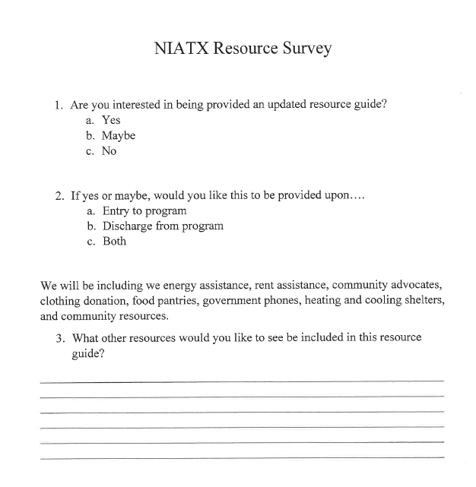
AIM
Receive a return survey from 60% of consumers in the TCM and CCM program indicating their interest in receiving a resource guide.
May 2022: 95 Consumers in program
Percent of consumers responded : 62.5% (60 consumers)
88.33% Yes
5% Maybe
6.66% No

Slide 3
Goal
Receive positive response from consumers to create an accessible resource guide to increase knowledge of community resources and promote independence.

Slide 4
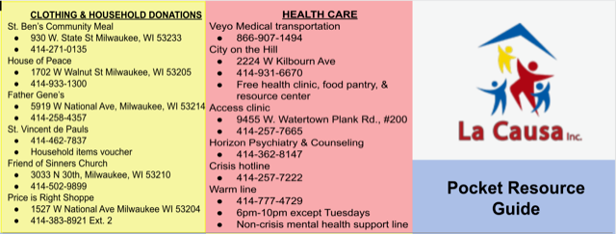
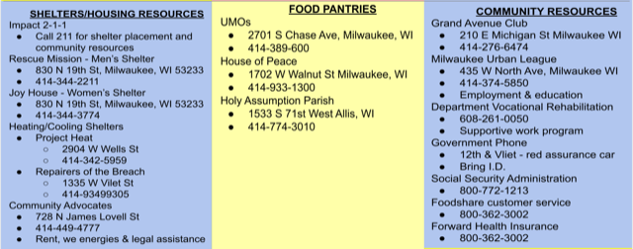
Pocket Resource Guide

Slide 5
Next Steps
Finalize
Finalize resource guide
Print
Print resource guide
Distribute
Distribute to consumers
Receive
Obtain post-survey response

