Slide 1
(Self)Care Coordination
Focusing on self-care for staff during challenging times
Community Based Mental Health Programs

Slide 2
Who, What, and Why
Burnout and high turnover have long been prominent issues facing the field of social work
Current CBMHP turnover rate: 32%, much higher since COVID-19 pandemic
Studies have shown that social workers understand the importance of self-care, but only engage moderately in self-care practices
Practice of self-care activities has decreased among social workers since the start of the COVID-19 pandemic (Miller and Cassar, 2021)
Our aim is to engage staff in an activity that will promote awareness of self-care and lead to an increase in self-care practices
The Change Team
Executive Sponsor: Susan Collyard, CBMHP Program Director
Change Leader: Alec Treharne
Change Team: Sara Glodowski-Sandee, Neiser Gunn, and Leticia Mayes

Slide 3
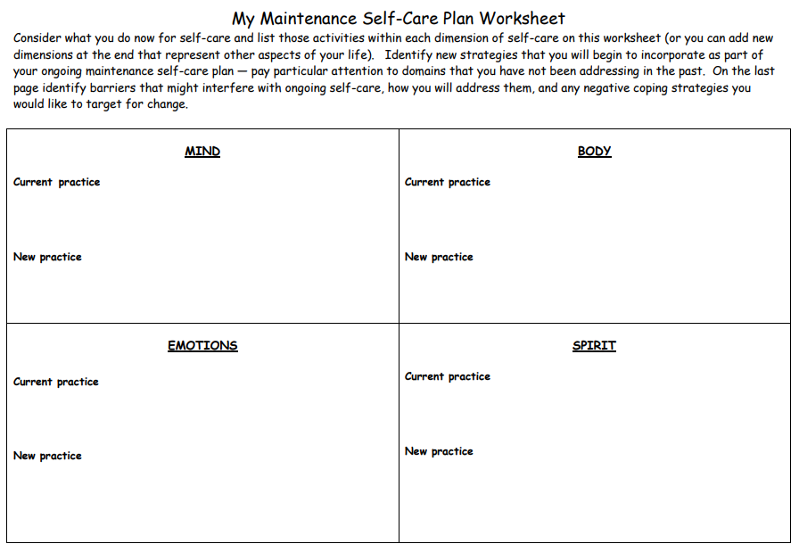
Project Details
To measure levels of self-care, we conducted a pre- and post-test using Erica Diamond’s “Essential Self-Care Quiz”
A portion of a day was set aside for participating staff to mingle, relax with some healthy snacks, take the pre-test, and develop a self-care plan with the My Maintenance Worksheet
20 CBMHP staff participated and were sent reminders and informational self-care tidbits over the three months leading up to the post-test

Slide 4
Data Collection
The Essential Self-Care Quiz
17 “agree or disagree” questions asking if the participant engages in various self-care activities such as taking time for oneself, healthy diet and exercise behavior, adequate sleep, socializing, mindfulness, and more
Each “agree” response = 1 point
0-5 points = “bottom of your own list”, 6-11 points = “some self-care”, 12-17 points = “self-care pro”
Pre-test: May 20th, 2022 – 20 participants
Post-test: August 19th, 2022 – 17 participants (3 staff left the agency)

Slide 5
Data Results
13/17 participants who completed the program had an increased score
Zero participants had a decreased score

Slide 6
What was Learned?
Despite being aware of self-care and its importance, our pre-test scores seem to align with previous findings that those in the social work field are not always practicing self-care as much as they should
Post-test data shows an increase in average scores and a significant number of new “self-care pros”
Staff feedback: positive reviews of the project
Thinking more about self-care, saw some improvement and met specific goals, increased walking, worked on swimming, making a conscious effort
Adoption: Due to what we see as a big success with this project, we will continue to offer the self-care plan in conjunction with staff appreciation events to be held quarterly

Slide 7
References
J. Jay Miller PhD, MSW & Jennifer Reddin Cassar JD, MSW (2021) Self-care among healthcare social workers: The impact of COVID-19, Social Work in Health Care, 60:1, 30-48, DOI: 10.1080/00981389.2021.1885560
My Maintenance Self-Care Plan Worksheet. Retrieved from https://socialwork.buffalo.edu/content/dam/socialwork/home/self-care-kit/my-maintenance-self-care-worksheet.pdf
The Essential Self-Care Quiz. Retrieved from https://ericadiamond.com/the-essential-self-care-quiz/

