Slide 1
Transforming Spaces: Changing Lives
4th Dimension Sobriety

Slide 2
ABOUT US
We help individuals looking for help with addiction and in need of sober living. Sober living communities not only break this cycle but also create thriving members of society. 4th Dimension Sobriety provides a safe and secure home while men and women transition into this life-long commitment. Its communal living approach offers a built-in support network that fosters an unbreakable bond between community members.

Slide 3
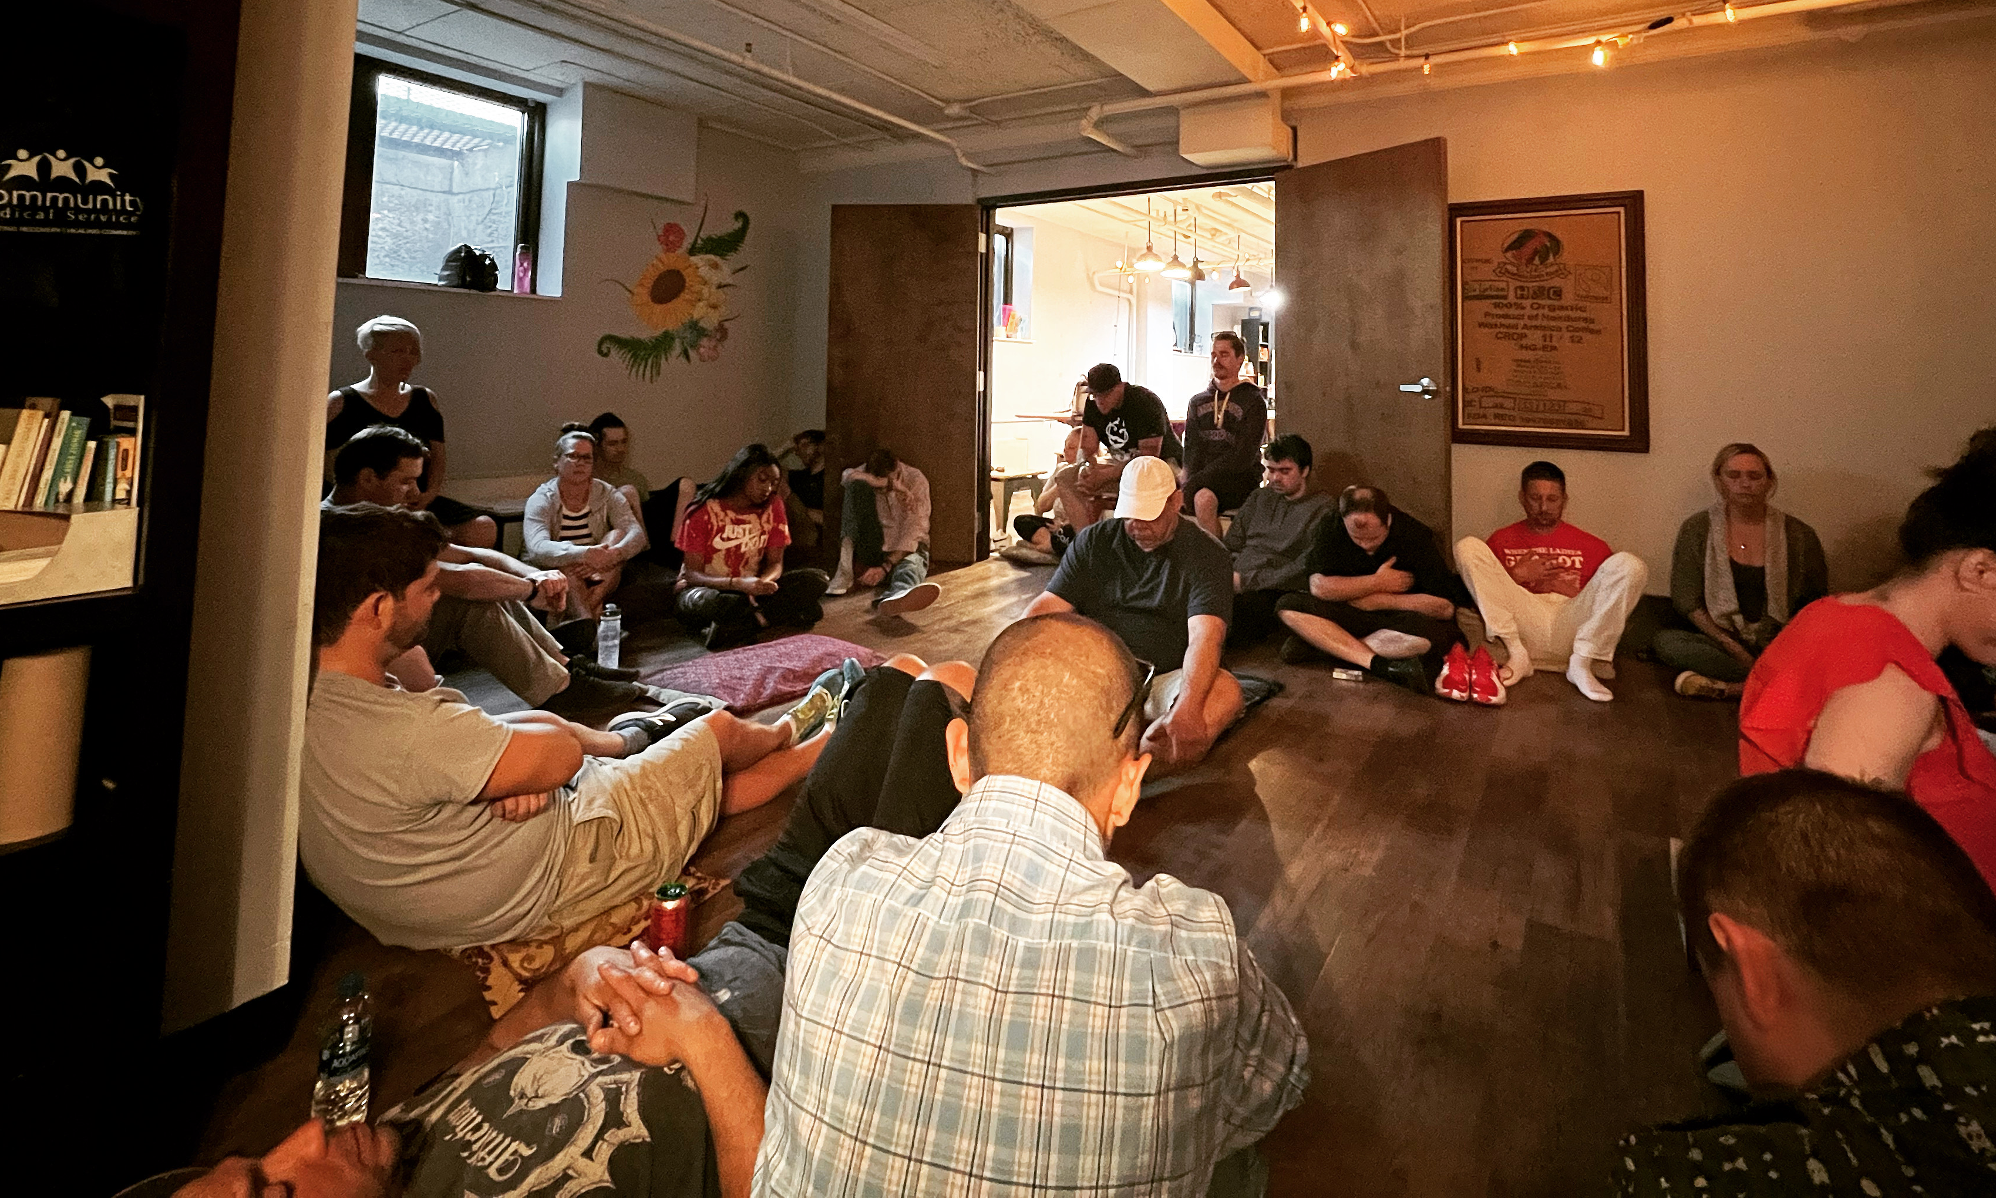
Project OVERVIEW
Transforming the space
In our endeavor to enhance the overall well-being of residents at the recovery center, we are embarking on a transformative project focused on revitalizing communal spaces. Recognizing the pivotal role these areas play in fostering a sense of community, support, and comfort, our project aims to create an environment that is not only aesthetically pleasing but also conducive to the holistic recovery of individuals.

Slide 4
Challenges
Making communal spaces more inviting, inclusive and comfortable
Available space
Limited resources
Maximizing the comfort in a small space poses a unique challenge, requiring thoughtful design and strategic utilization to ensure a welcoming environment for our residents.
Balancing the aspiration for a welcoming space with limited resources challenges us to innovate and craft a comfortable environment for our guests with creativity and resourcefulness.
Diverse resident needs
Addressing diverse client needs while designing this space necessitates a delicate balance, ensuring that every aspect caters to various preferences, comfort levels, and requirements for an inclusive and welcoming environment.

Slide 5
objectives
Promoting Inclusivity
Enhancing Comfort
Fostering Connection
Mindful Design
Resourceful Utilization
Client-Centric Approach

Slide 6
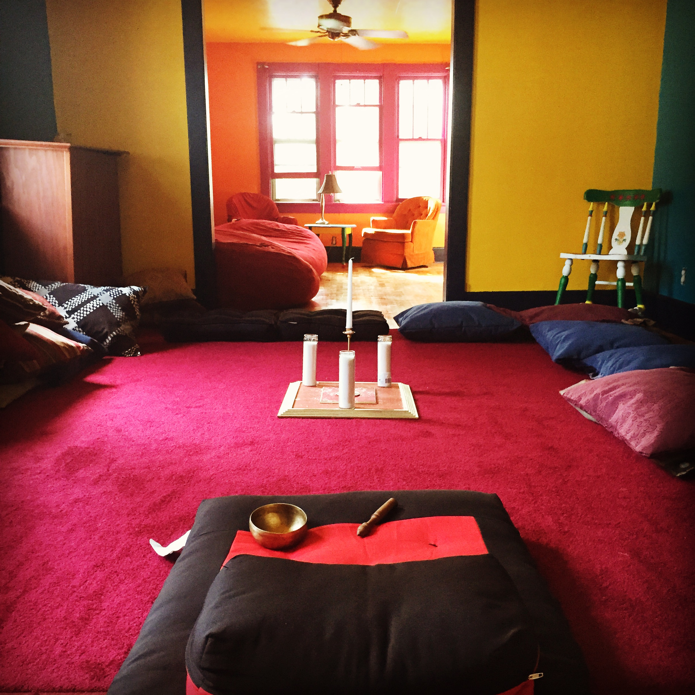
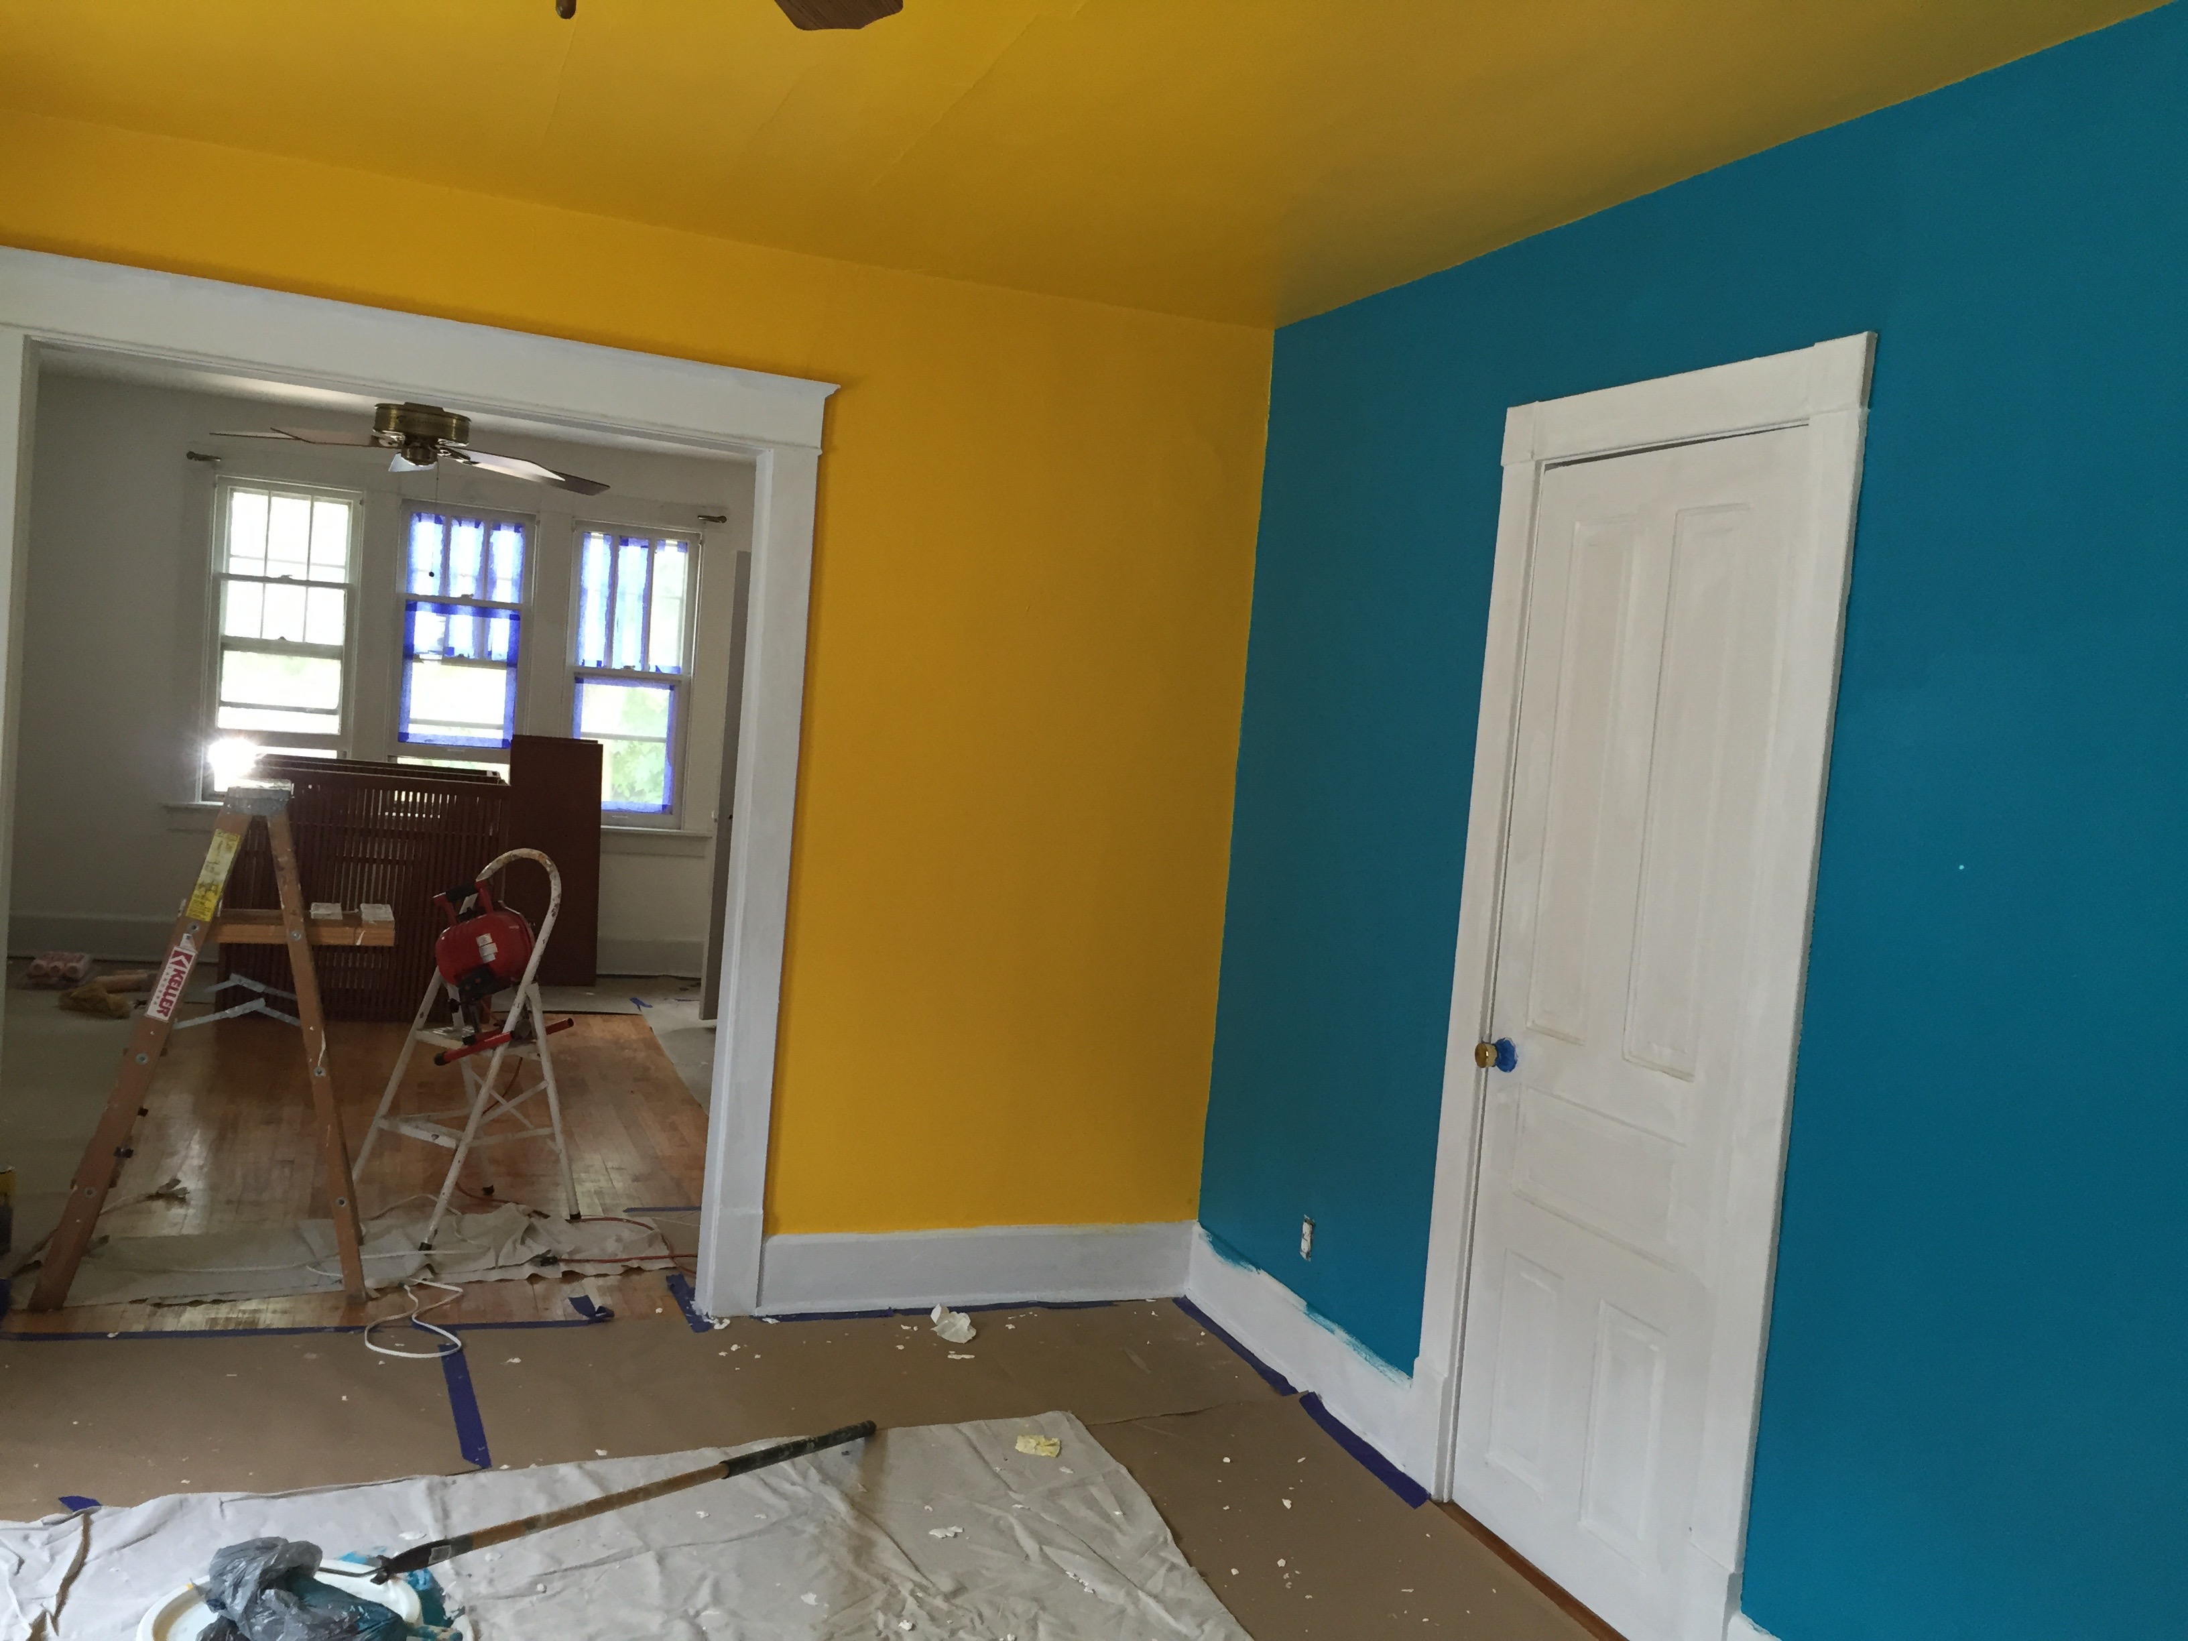
results
The transformative project has yielded remarkable results in enhancing the communal spaces at the recovery center. Residents now experience a palpable sense of belonging and comfort, fostering positive social interactions and mutual support. The thoughtfully designed spaces, coupled with mindful utilization of resources, have not only elevated the aesthetics but also contributed significantly to the overall well-being and therapeutic atmosphere within the center.

