Slide 1
Mission Recognition
United Community Center

Slide 2
Organization Overview
The United Community Center (UCC) Human Services Department is a certified provider of mental health and substance use disorder treatment programs.

Slide 3
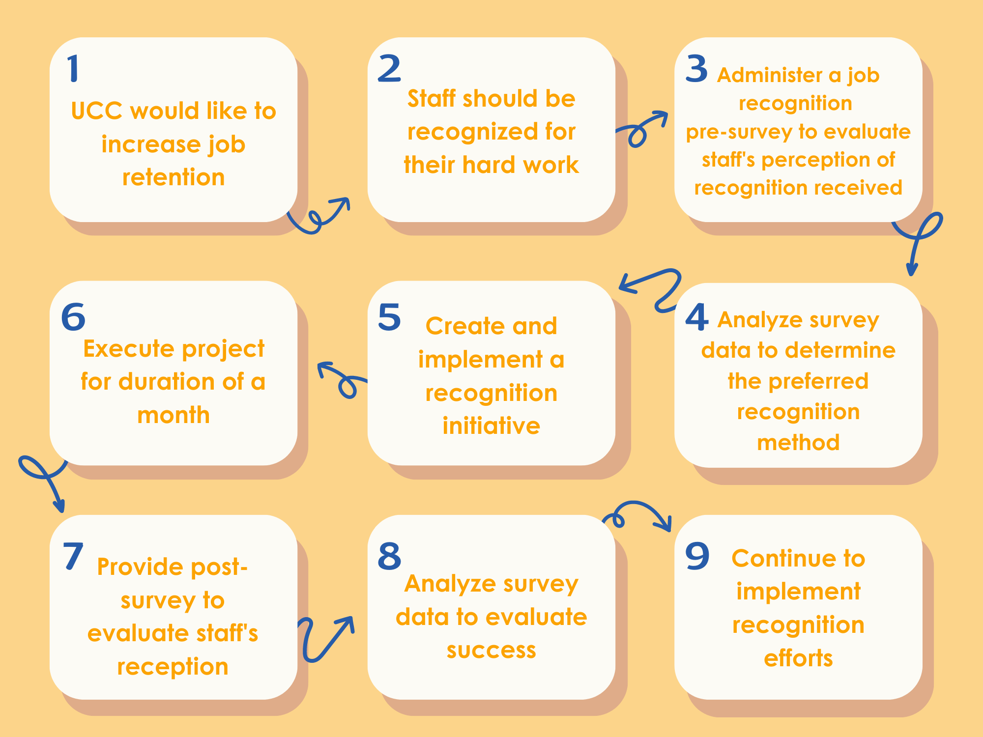
Overview of Change Cycle
Aim Statement
Increase Human Services Department recognition perception by implementing feedback surveys.

Slide 4
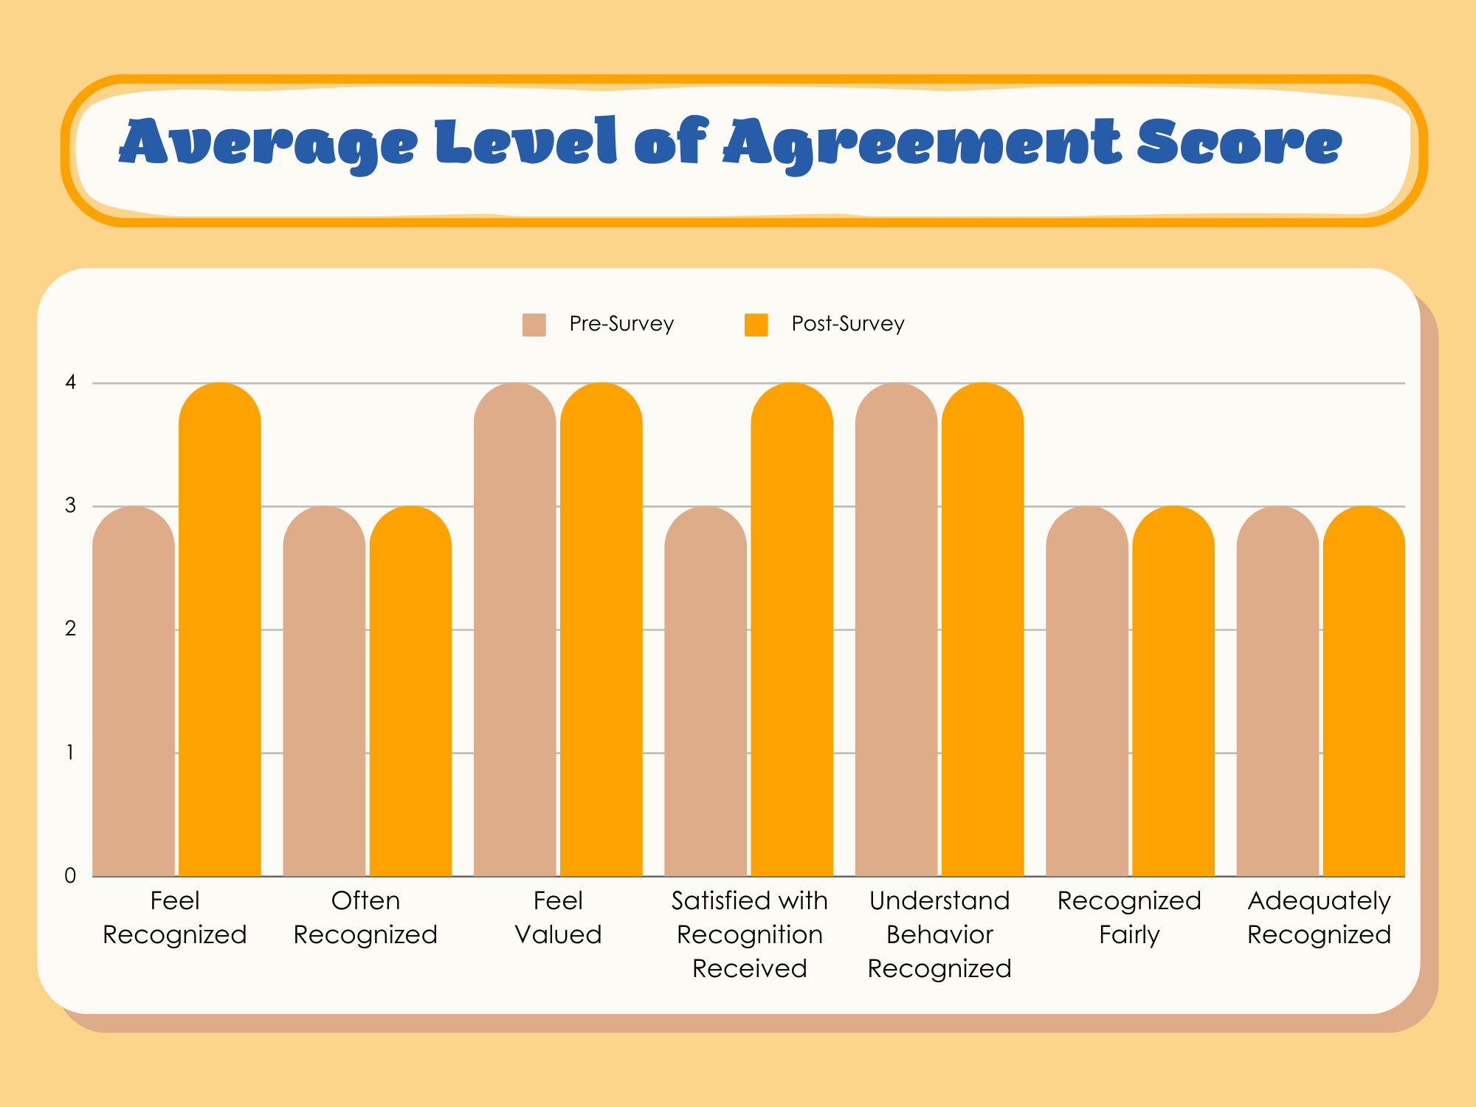
Post-Survey Results
Impact
Looking at the average score for each statement and comparing the pre-survey and the post-survey we see a slight increase in score in some of the statements.
When looking at the comments staff members left, there was a mix of positive and negative reviews. While some reported not seeing any changes those who did were very appreciative of it.

Slide 5
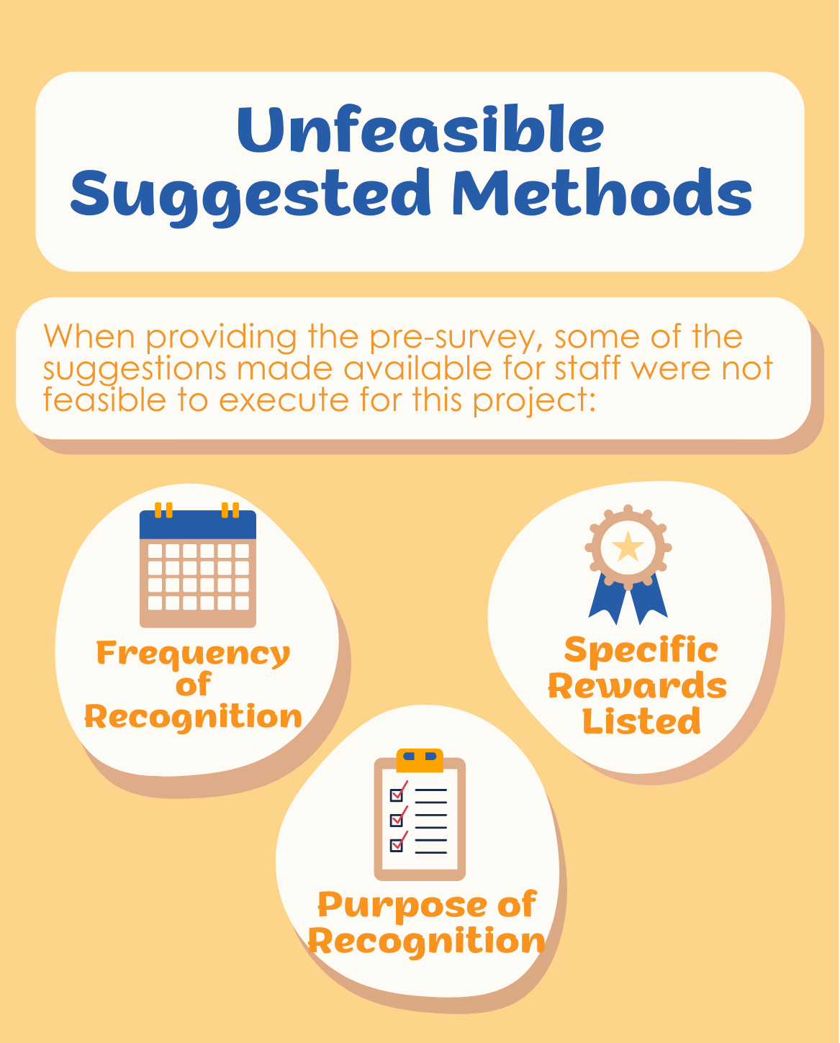
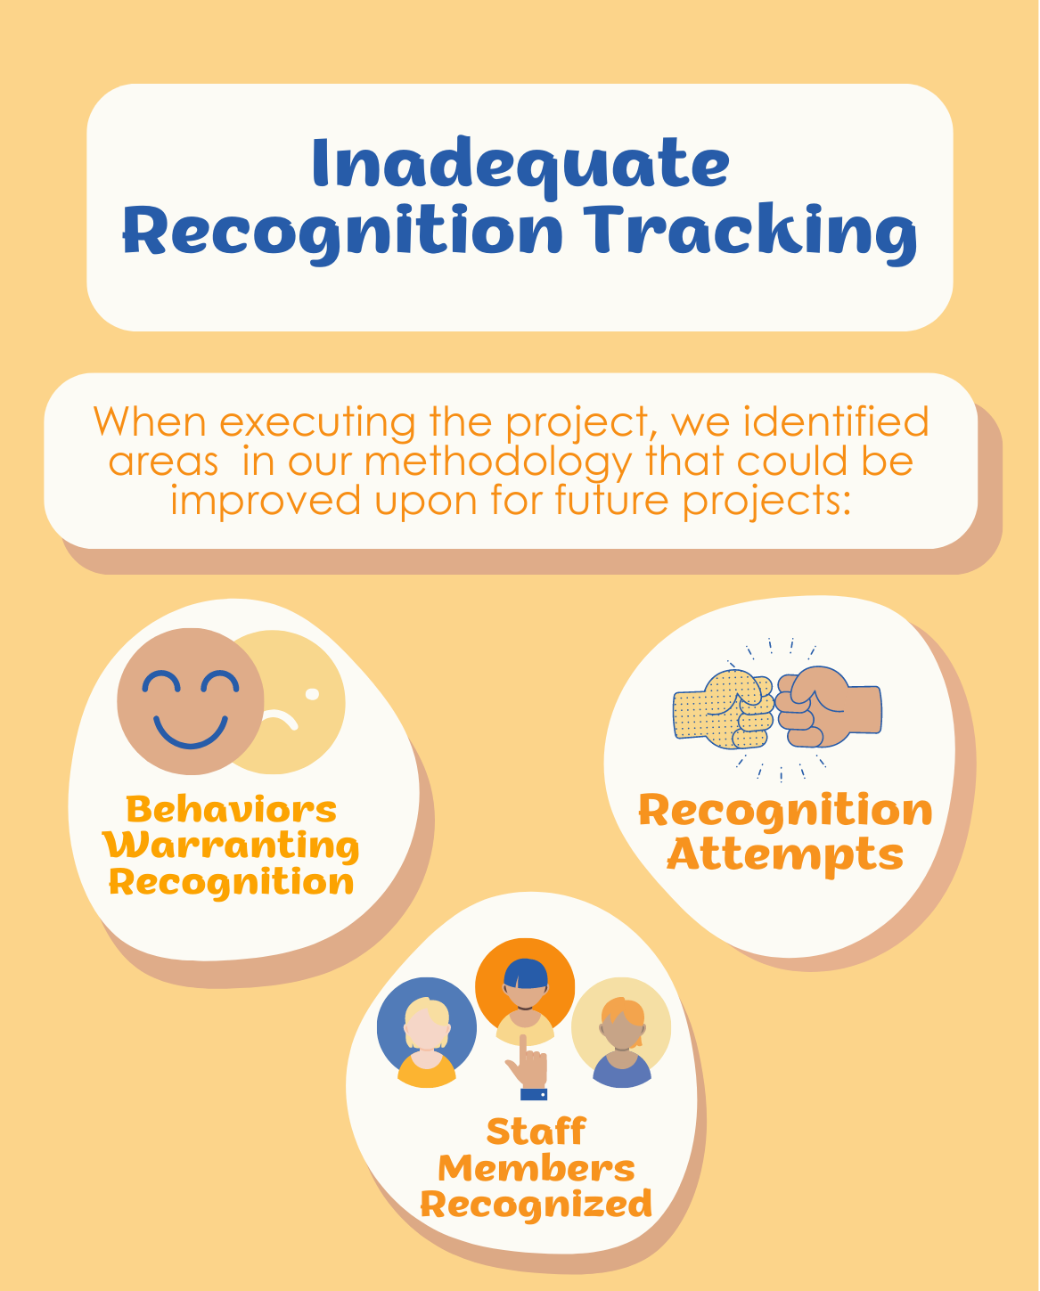
Challenges

Slide 6
Wins

Slide 7
Final Project Outcome

